Slide 1

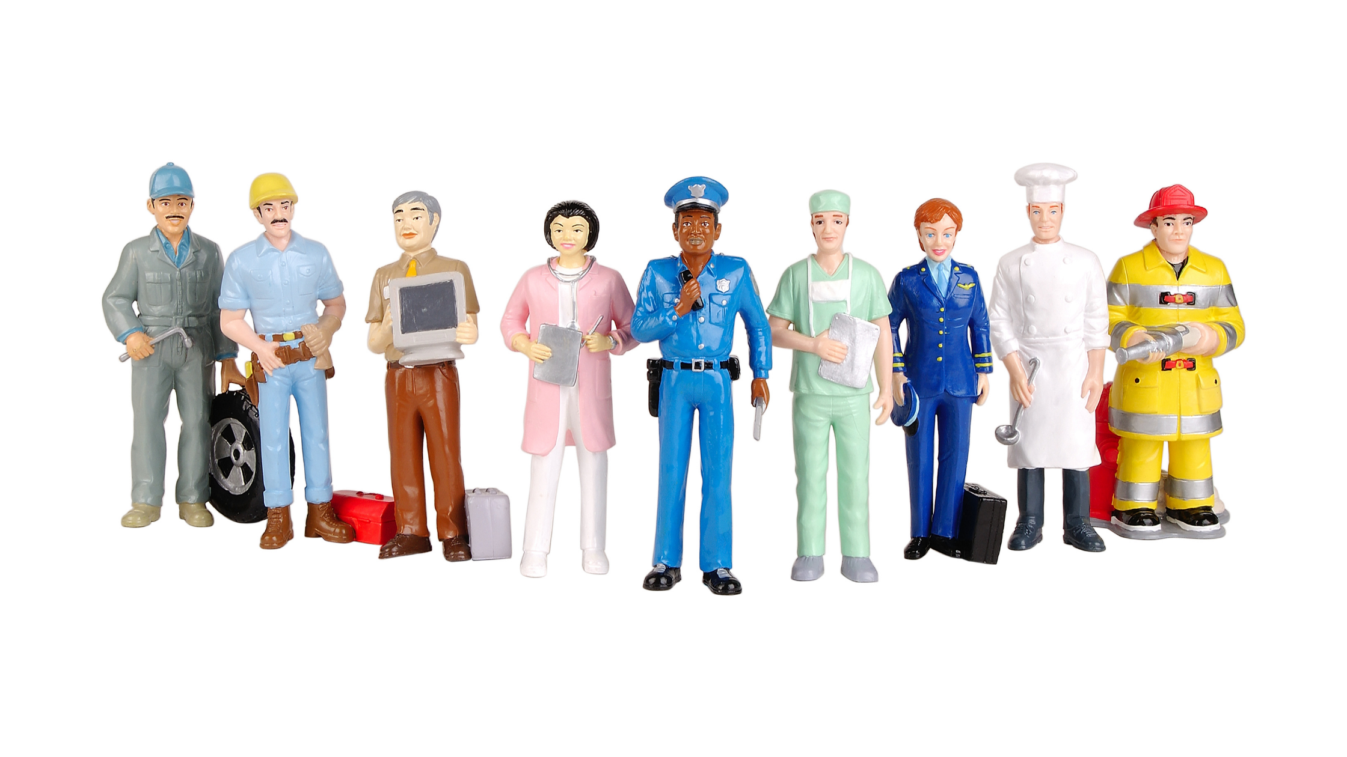
4th grade: Occupations guessing game!

Slide 2
Reveal the picture by saying the number
First student to guess and write the name of the picture correctly in the chat wins!

Slide 3
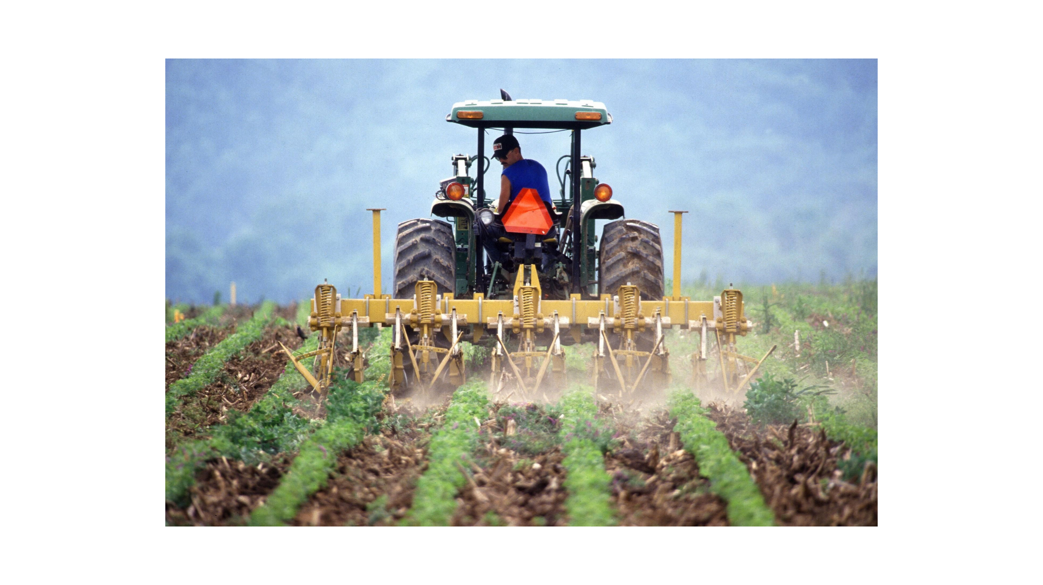
1
2
3
4
5
FARMER
6
7
8
9
10
11
12
13
14
15
SHOW PICTURE!
16
17
18
19
20

Slide 4

1
2
3
4
5
POLICE OFFICER
6
7
8
9
10
11
12
13
14
15
SHOW PICTURE!
16
17
18
19
20

Slide 5
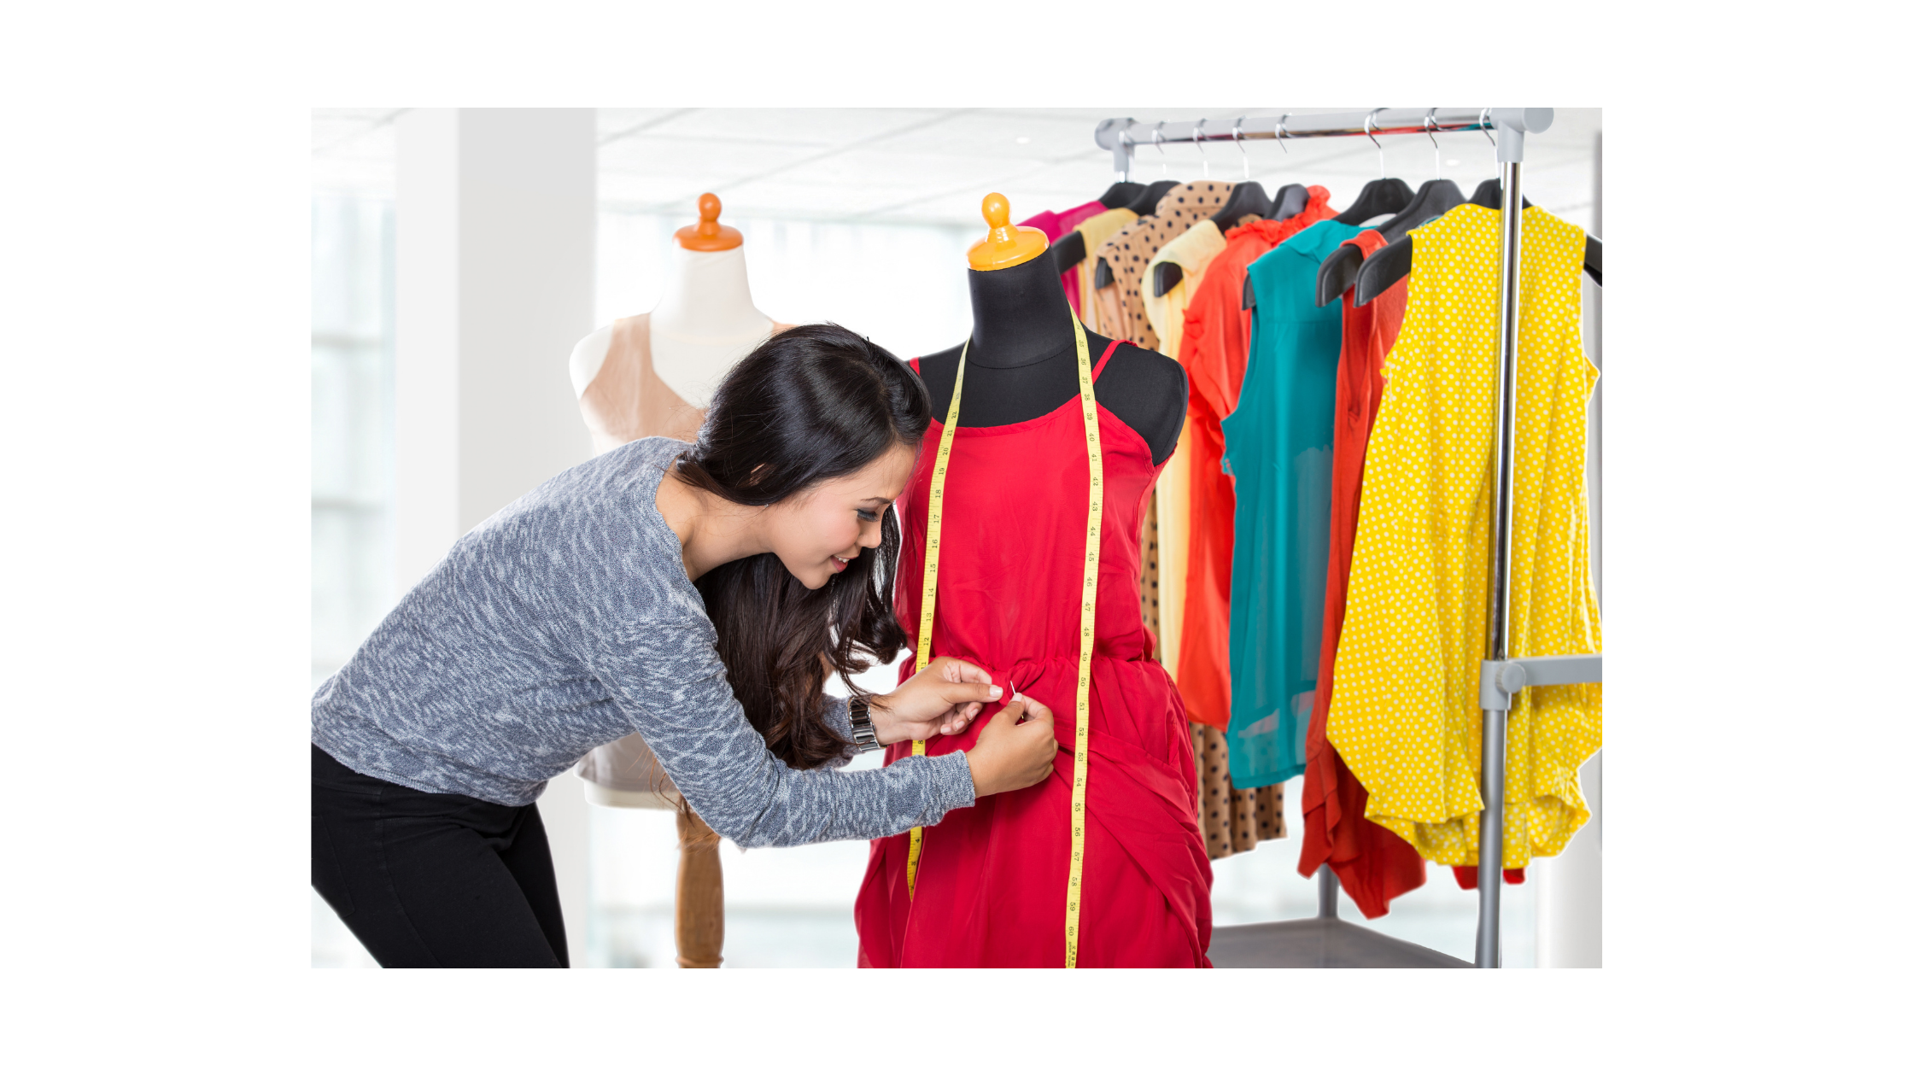
1
2
3
4
5
FASHION DESIGNER
6
7
8
9
10
11
12
13
14
15
SHOW PICTURE!
16
17
18
19
20

Slide 6

1
2
3
4
5
SINGER
6
7
8
9
10
11
12
13
14
15
SHOW PICTURE!
16
17
18
19
20

Slide 7

1
2
3
4
5
TAXI DRIVER
6
7
8
9
10
11
12
13
14
15
SHOW PICTURE!
16
17
18
19
20

Slide 8

1
2
3
4
5
VET
6
7
8
9
10
11
12
13
14
15
SHOW PICTURE!
16
17
18
19
20

Slide 9

1
2
3
4
5
SHOP ASSISTANT
6
7
8
9
10
11
12
13
14
15
SHOW PICTURE!
16
17
18
19
20

Slide 10

1
2
3
4
5
WRITER
6
7
8
9
10
11
12
13
14
15
SHOW PICTURE!
16
17
18
19
20

Slide 12

Hello teachers
To help you prepare activities for distance teaching, we have created different templates to create material, contextualized games for practicing content of our curriculum and spreadsheets for data management.
These resources are part of an online teacher resource pack for you.
You are more than welcome to use and customize them as you need.
You can download this template and more resources from the website www.oportunidadenlinea.cl
See you soon.

