Slide 1


3RD GRADE: ANIMALS GUESSING GAME!

Slide 2
Reveal the picture by saying the number
First student to guess and write the name of the animal correctly in the chat wins!

Slide 3
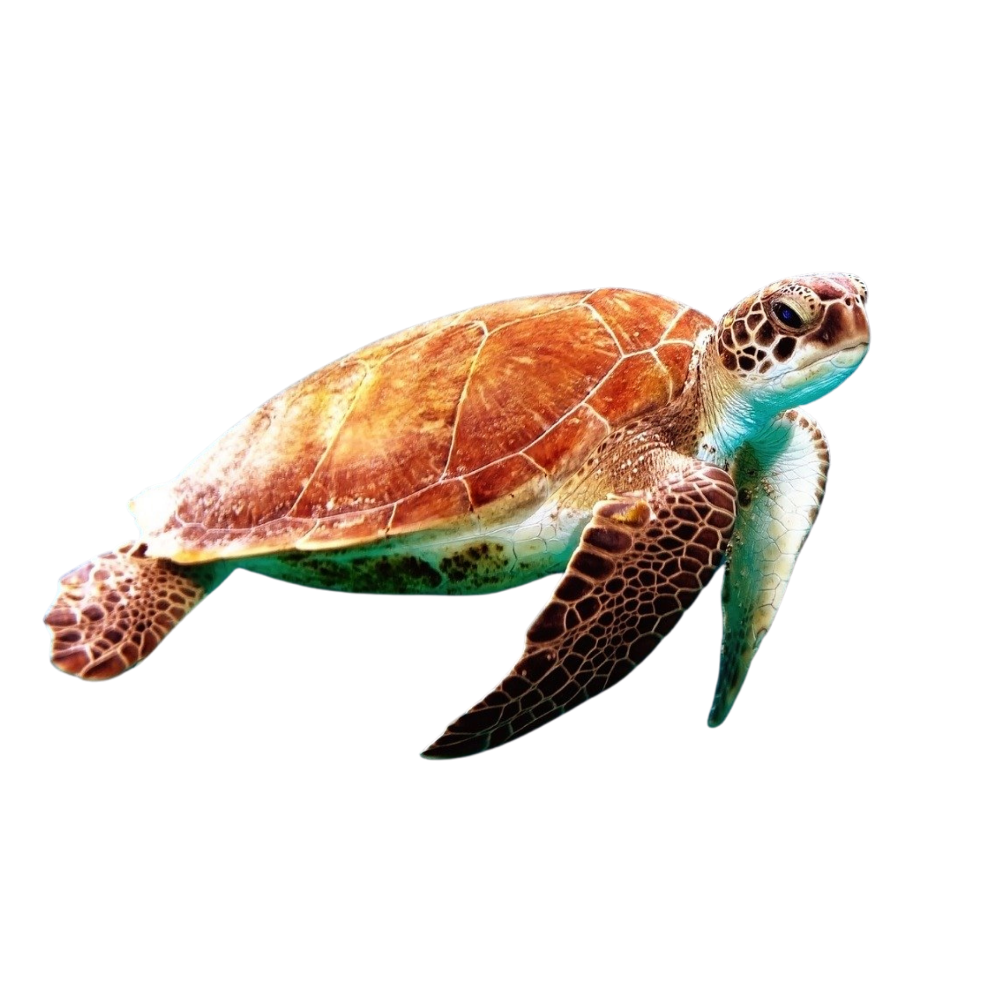
1
2
3
4
5
TORTOISE
6
7
8
9
10
11
12
13
14
15
SHOW PICTURE!
16
17
18
19
20

Slide 4

The tortoise has got a shell

Slide 5
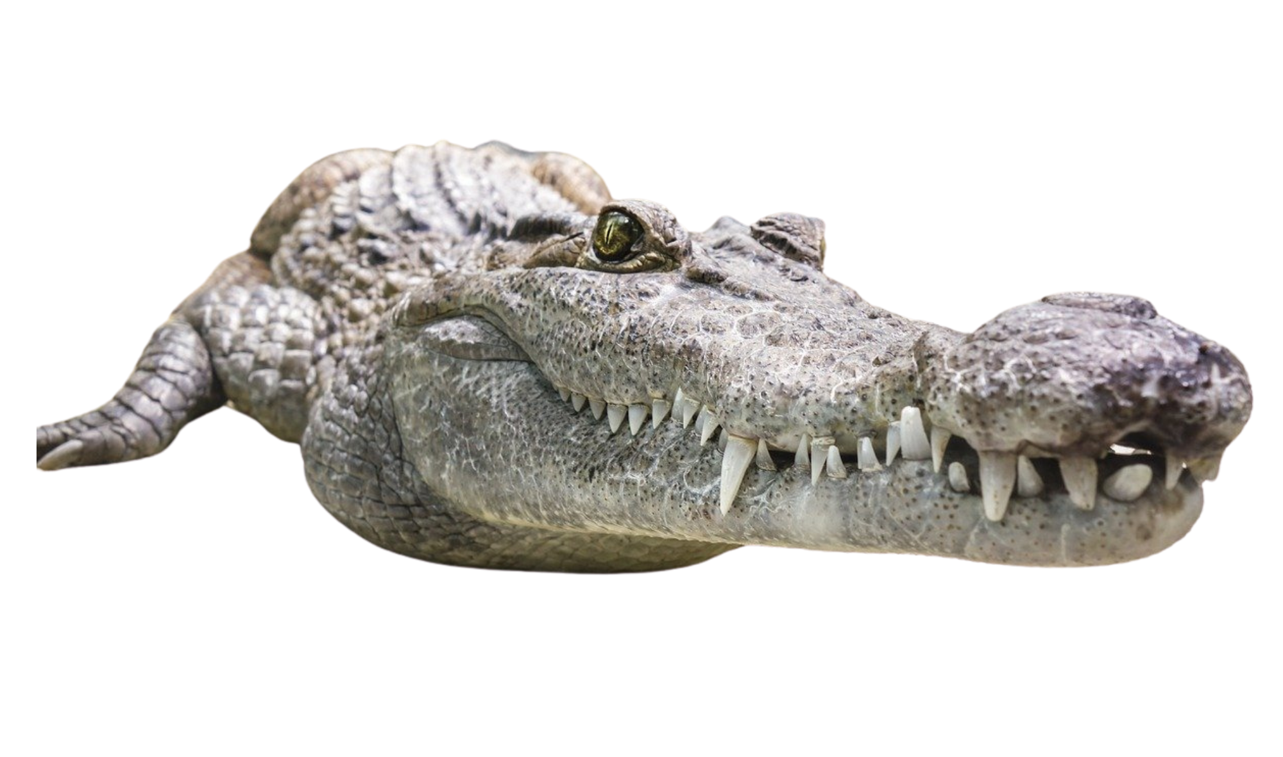
1
2
3
4
5
CROCODILE
6
7
8
9
10
11
12
13
14
15
SHOW PICTURE!
16
17
18
19
20

Slide 6
The crocodile has got teeth

Slide 7
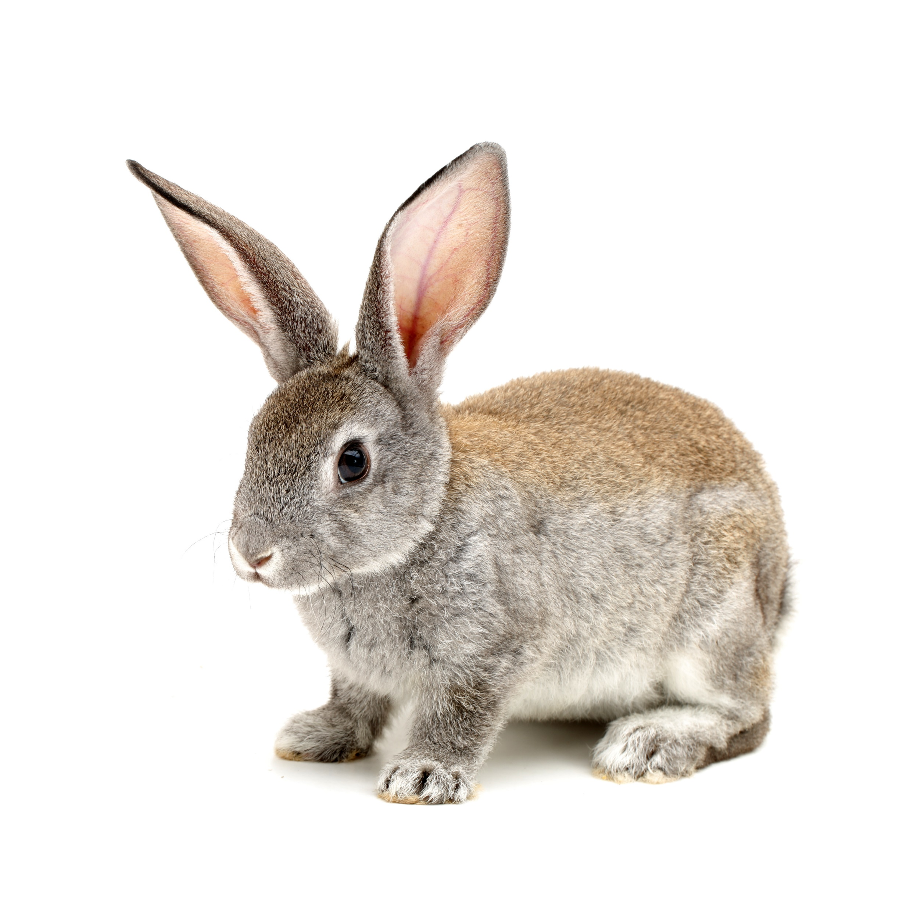
1
2
3
4
5
RABBIT
6
7
8
9
10
11
12
13
14
15
SHOW PICTURE!
16
17
18
19
20

Slide 8
The rabbit has got fur

Slide 9
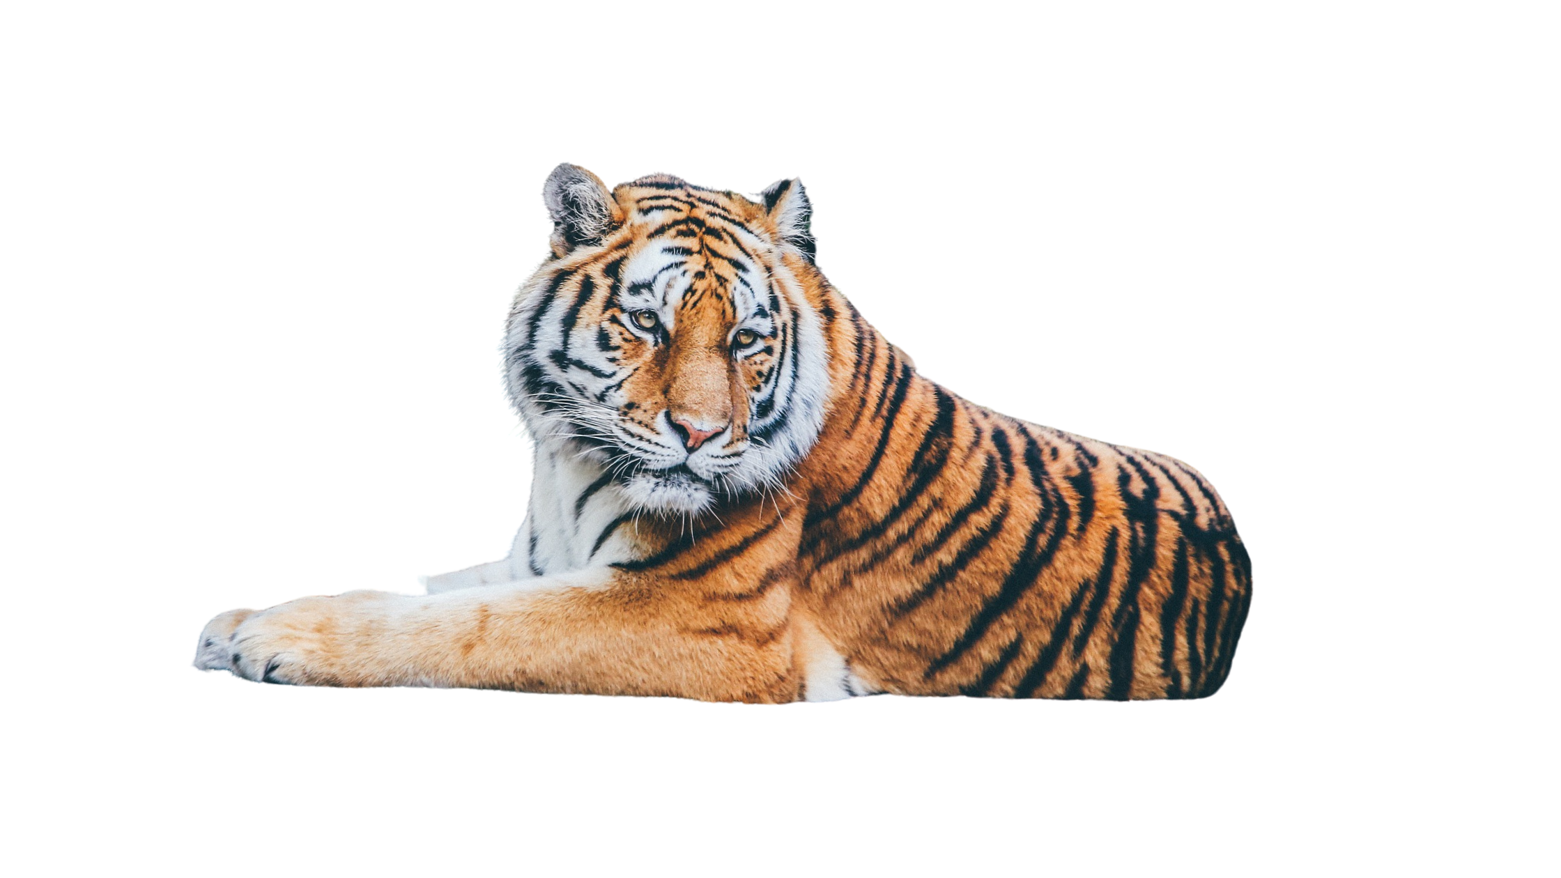
1
2
3
4
5
TIGER
6
7
8
9
10
11
12
13
14
15
SHOW PICTURE!
16
17
18
19
20

Slide 10
The tiger has got claws

Slide 11
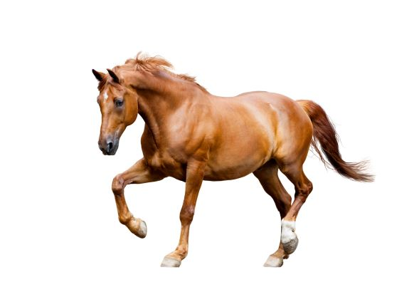
1
2
3
4
5
HORSE
6
7
8
9
10
11
12
13
14
15
SHOW PICTURE!
16
17
18
19
20

Slide 12
The horse has got a tail

Slide 13
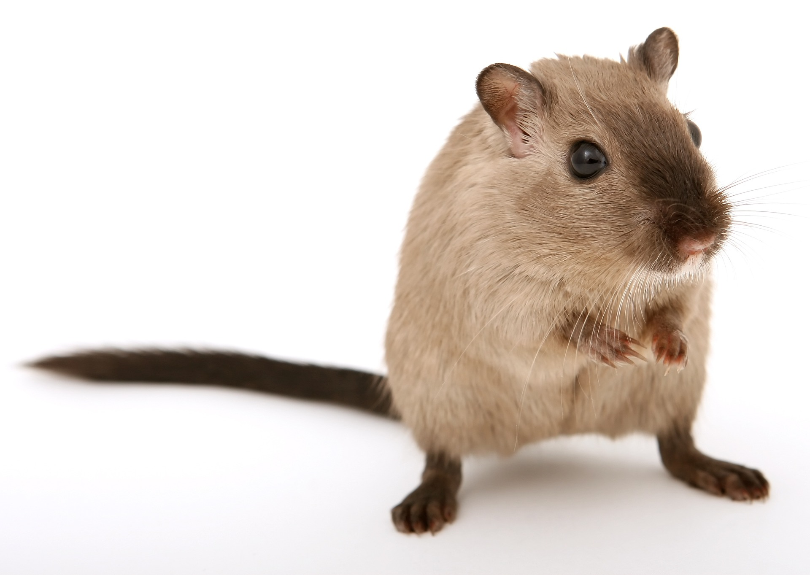
1
2
3
4
5
MOUSE
6
7
8
9
10
11
12
13
14
15
SHOW PICTURE!
16
17
18
19
20

Slide 14
The mouse has got whiskers

Slide 15
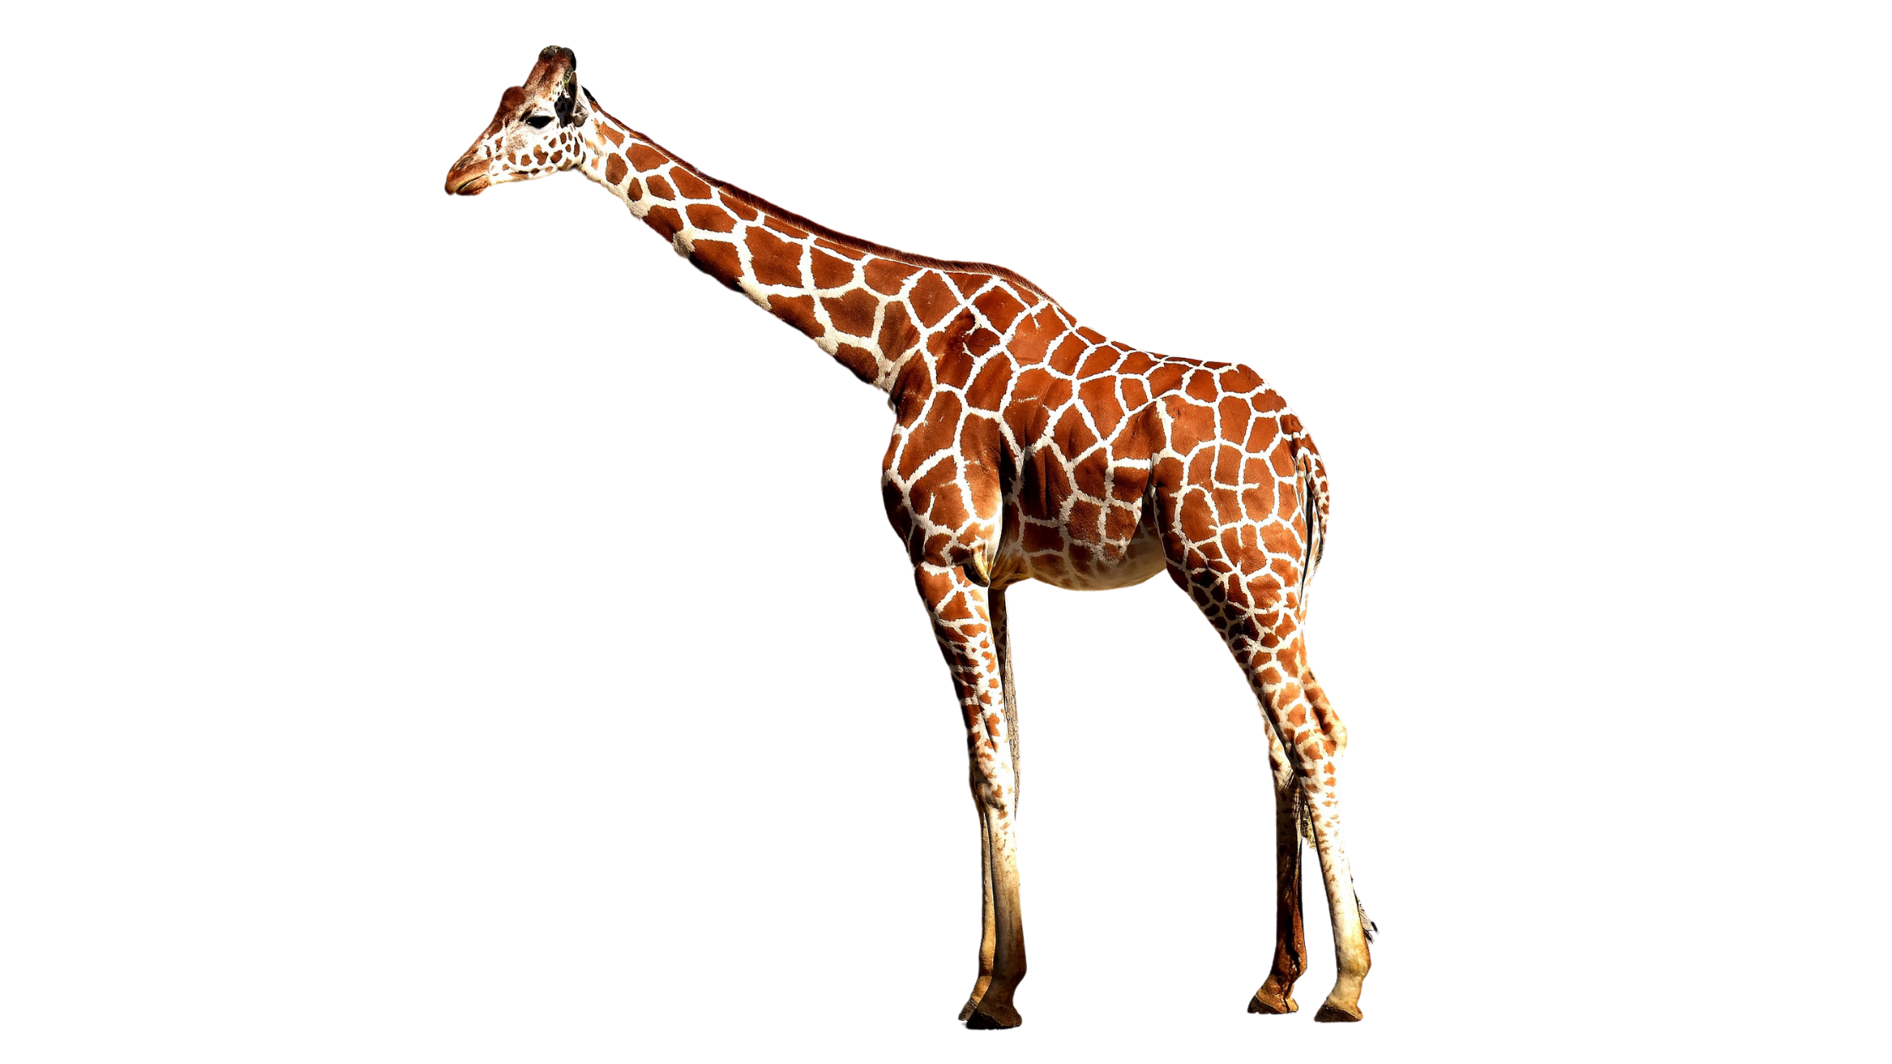
1
2
3
4
5
GIRAFFE
6
7
8
9
10
11
12
13
14
15
SHOW PICTURE!
16
17
18
19
20

Slide 16
The giraffe has got a long neck

Slide 17
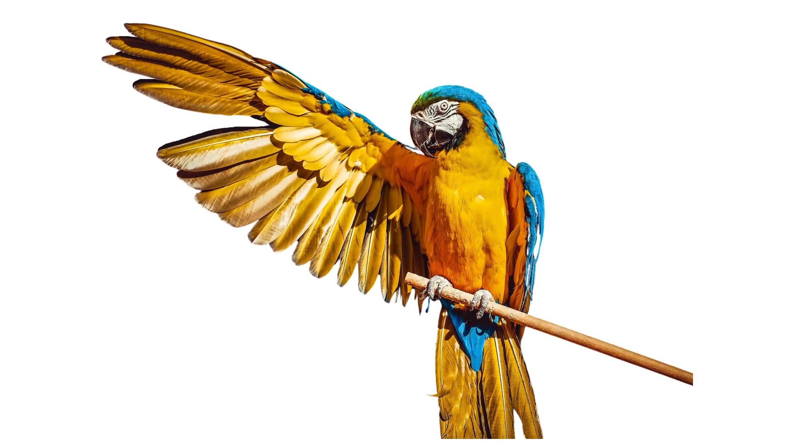
1
2
3
4
5
PARROT
6
7
8
9
10
11
12
13
14
15
SHOW PICTURE!
16
17
18
19
20

Slide 18
The parrot has got wings

Slide 20

Hello teachers
To help you prepare activities for distance teaching, we have created different templates to create material, contextualized games for practicing content of our curriculum and spreadsheets for data management.
These resources are part of an online teacher resource pack for you.
You are more than welcome to use and customize them as you need.
You can download this template and more resources from the website www.oportunidadenlinea.cl
See you soon.

