Slide 1
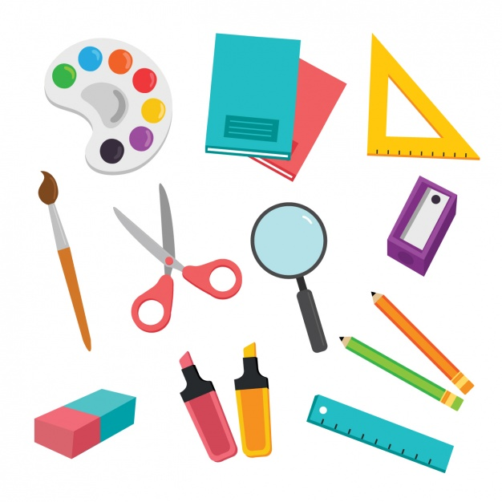

Kinder
Classroom objects memory game!

Slide 2


Do you like memory games
Instructions:
Add your Bitmoji and a message if you want to give a personal touch to the presentation.
Reveal the picture by clicking on the number​ the students say.
If they are incorrect, you have to click again on the same picture.
Let the picture reveal only if the pair is correct.
Have fun!
Memory games are a fabulous tool to improve memory, and children of all ages love to play! They also boost attention levels, reading ability, and reasoning skills. Playing memory games can improve other brain functions, such as attention, concentration, and focus. You can use them as ice-breakers or as a way to enhance visual recognition because they develop critical thinking.
Miss Karla

Slide 3
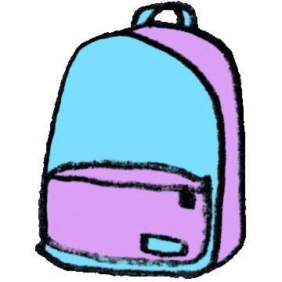
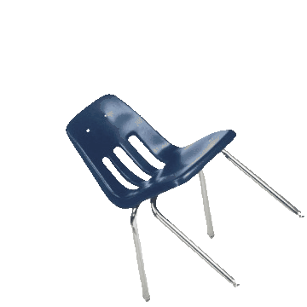


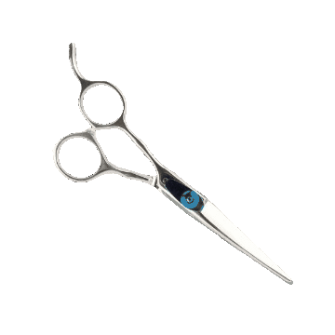
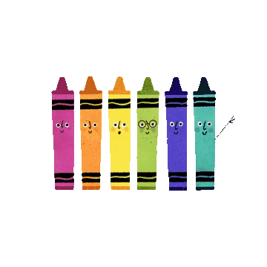
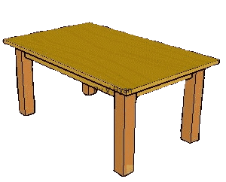
1
2
3
4
Crayons
5
6
7
8
Table
Book
Scissors
9
10
School bag
11
12
Chair

Slide 5

Hello teachers
To help you prepare activities for distance teaching, we have created different templates to create material, contextualized games for practicing content of our curriculum and spreadsheets for data management.
These resources are part of an online teacher resource pack for you.
You are more than welcome to use and customize them as you need.
You can download this template and more resources from the website www.oportunidadenlinea.cl
See you soon.

