Slide 1

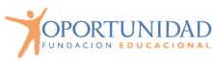
Instructions:
In the following slides, you will find different templates for ‘Virtual Classrooms’. You can add all the pictures you want to personalize your classroom.
Then, add your Bitmoji to it in different places, doing different activities like reading, dancing, working, asking, resting, etc. You only need to use your imagination.
You can use these ‘Virtual Classrooms’ as waiting rooms for your students, so you can ask about the elements they can see.
Some of the slides have a window, so you make questions to your students about the weather; others have laptops or tv sets. You can use them to show videos by placing a picture of the video you want to show and then link it to a web page like Youtube, Vimeo, etc.

Slide 2
Instructions:
The ‘Virtual Classrooms’ have bulleting boards or post-its that you can use to leave notes, add pictures to personalize your classroom or leave a link to websites that students can use. There is a bookcase too, so you can put the cover of a story, book, etc., that you are reading with your students.
By adding a text box, the whiteboards serve as a natural place for students to pay attention to the activities they are going to do during the class. You can write, for example, the date or the objectives of the lesson.
You can use these ‘Virtual Classrooms’ as transition slides. With your Bitmoji's help, you can ask your students questions, which is a perfect tool to interact with them, especially with asynchronous learning/teaching.
In the following slides, you will find some examples. Have fun!

Slide 3
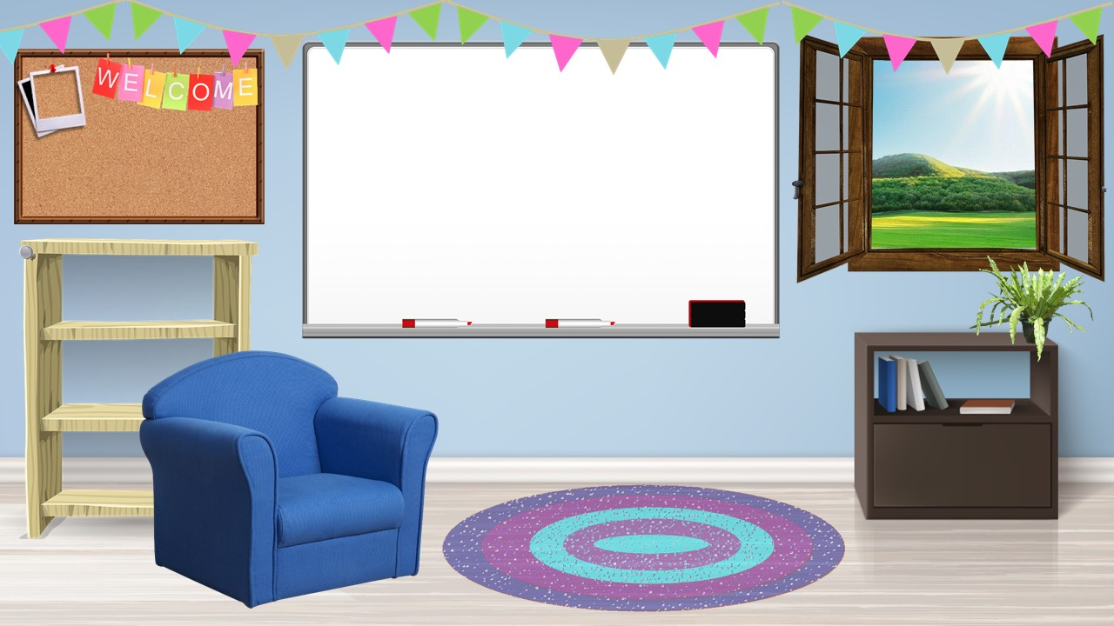





EXAMPLE

Slide 4
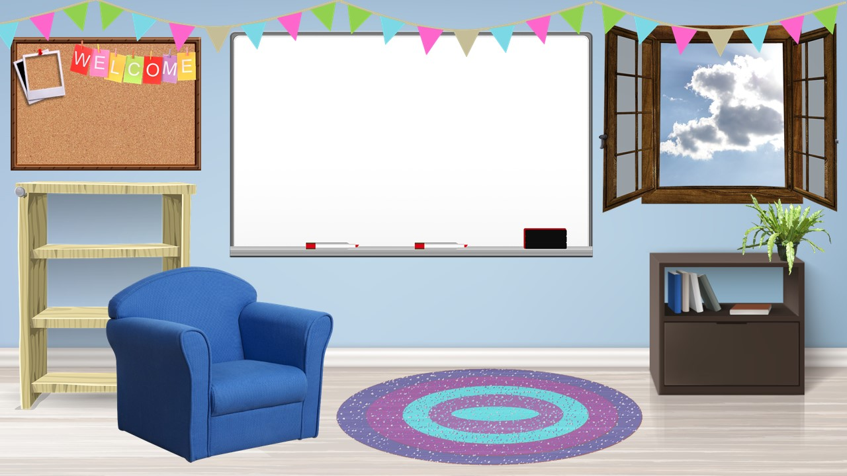

EXAMPLE
Date: (month, day, year)
INICIAR TEMPORIZADOR
TIME’S UP!
5
1
4
2
3
Hello everybody! We’re going to start in 5 minutes, thanks!

Slide 5
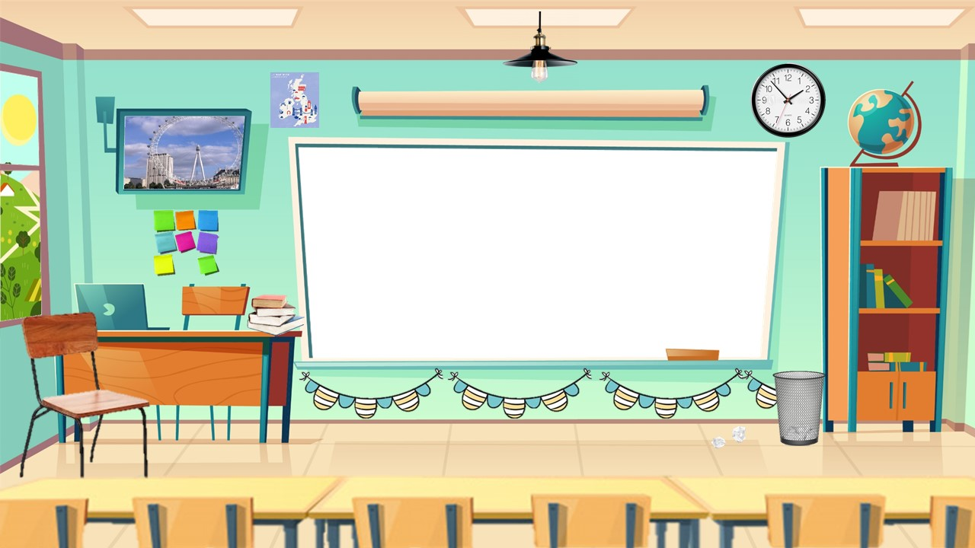


EXAMPLE
Date: (month, day, year)
Hello dear students! Let’s look through the window. What’s the weather like today?

Slide 31

Hello teachers
To help you prepare activities for distance teaching, we have created different templates to create material, contextualized games for practicing content of our curriculum and spreadsheets for data management.
These resources are part of an online teacher resource pack for you.
You are more than welcome to use and customize them as you need.
You can download this template and more resources from the website www.oportunidadenlinea.cl
See you soon.

