Slide 1


Checklists
A checklist can be a super useful resource to evaluate your students.
It helps them understand how to improve in a clear, specific, and easy way.
If you are looking to use this strategy with your class, we want to help!
Just check the following instructions.
Instructions
These slides will help you create checklists to use with your students.
In the next slide you are going to find an example. After the example, you will find 6 different templates. You can change the information, add something cute to give positive reinforcement and even copy the slides you need to send to your students.
When you finish, you can save them as images and send them by email or WhatsApp.
Logos you may need:
Insert your school’s badge so you can have quick access to it when needed.

Slide 2
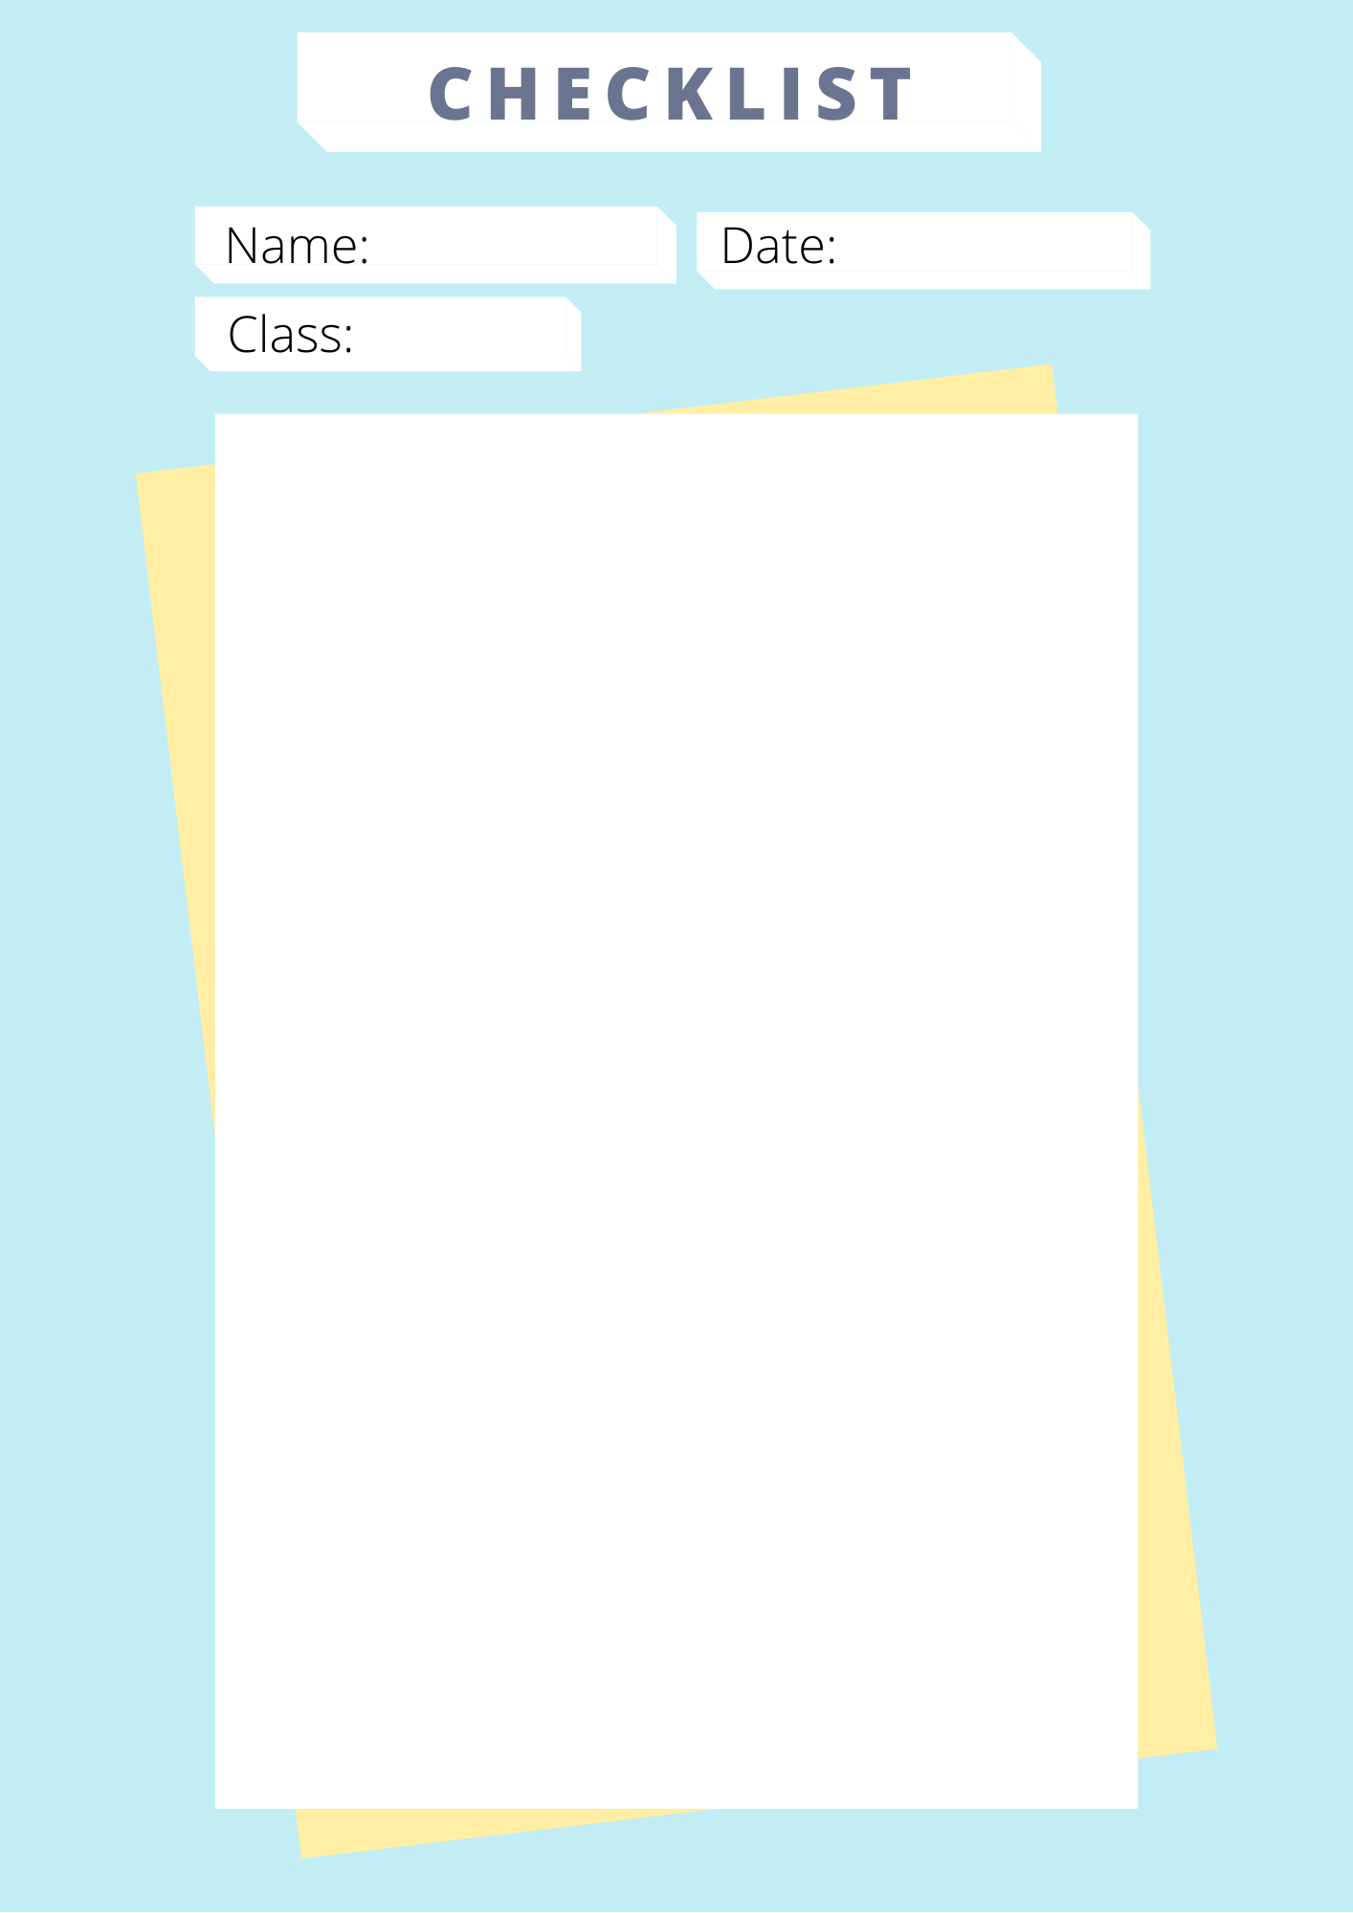

EXAMPLE
John Doe
September 15th
7th grade
The student:
says hello at the beginning of the class.
uses English during the class.
follows the instructions of the class.
participates in at least one activity in the class.
names three new words from the class.
says goodbye at the end of the class.
Total tickets
Miss Fernanda

Slide 3
Add your school logo here
Activity´s date
Students' name
Grade
The student:
Add text here.
Add text here.
Add text here
Add text here
Add text here
Add text here
Add your Bitmoji, sticker or signature here
Total tickets
Add your name here

Slide 4
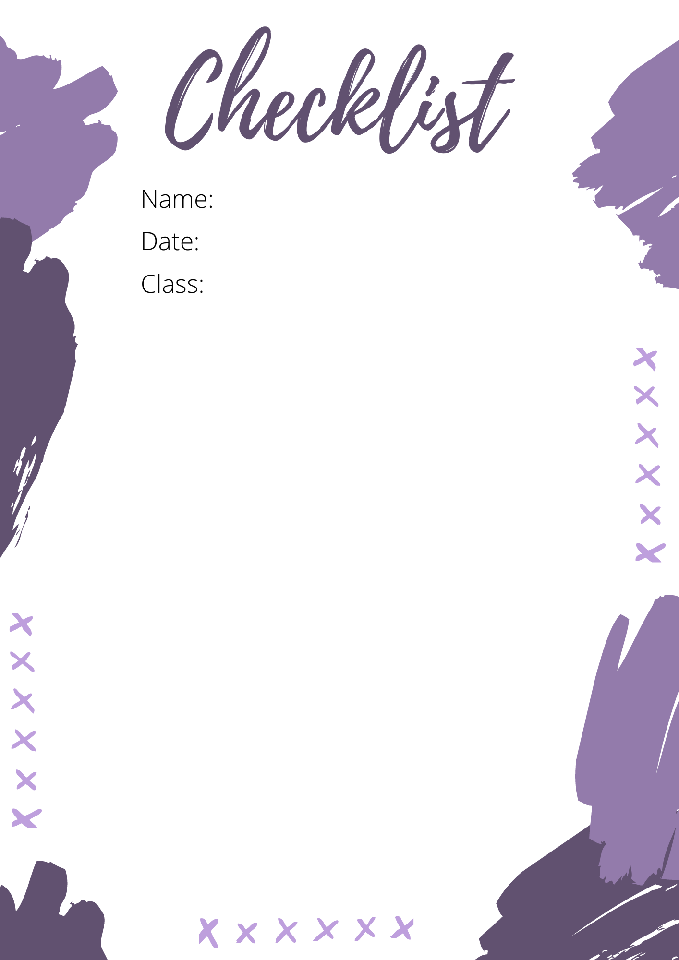
Students' name
Activity´s date
Grade
The student:
Add text here.
Add text here
Add text here
Add text here
Add your Bitmoji, sticker or signature here
Add your name here

Slide 5
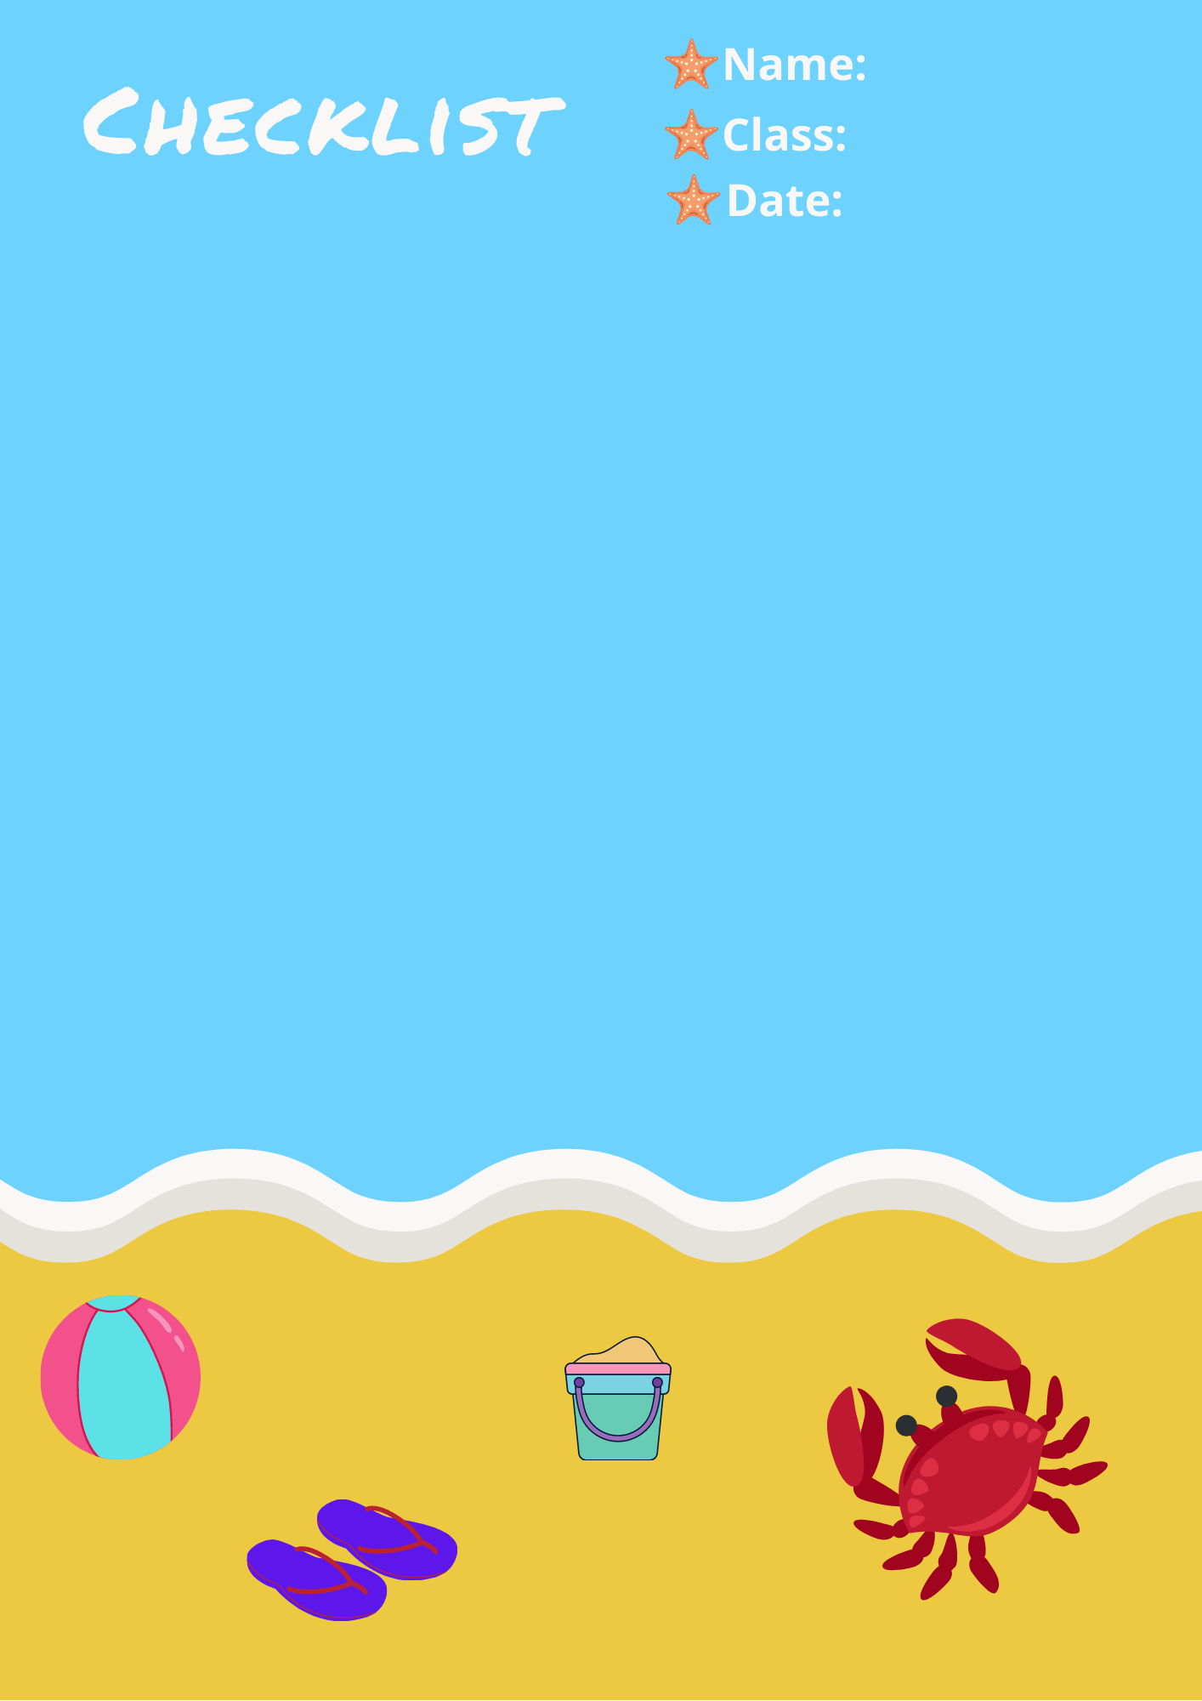
Students' name
Activity´s date
Grade
The student:
Add text here.
Add text here
Add text here
Add text here
Add your Bitmoji, sticker or signature here
Add your name here

Slide 6

Students' name
Activity´s date
Grade
The student:
Add text here.
Add text here
Add text here
Add text here
Add your Bitmoji, sticker or signature here
Add your name here

Slide 7
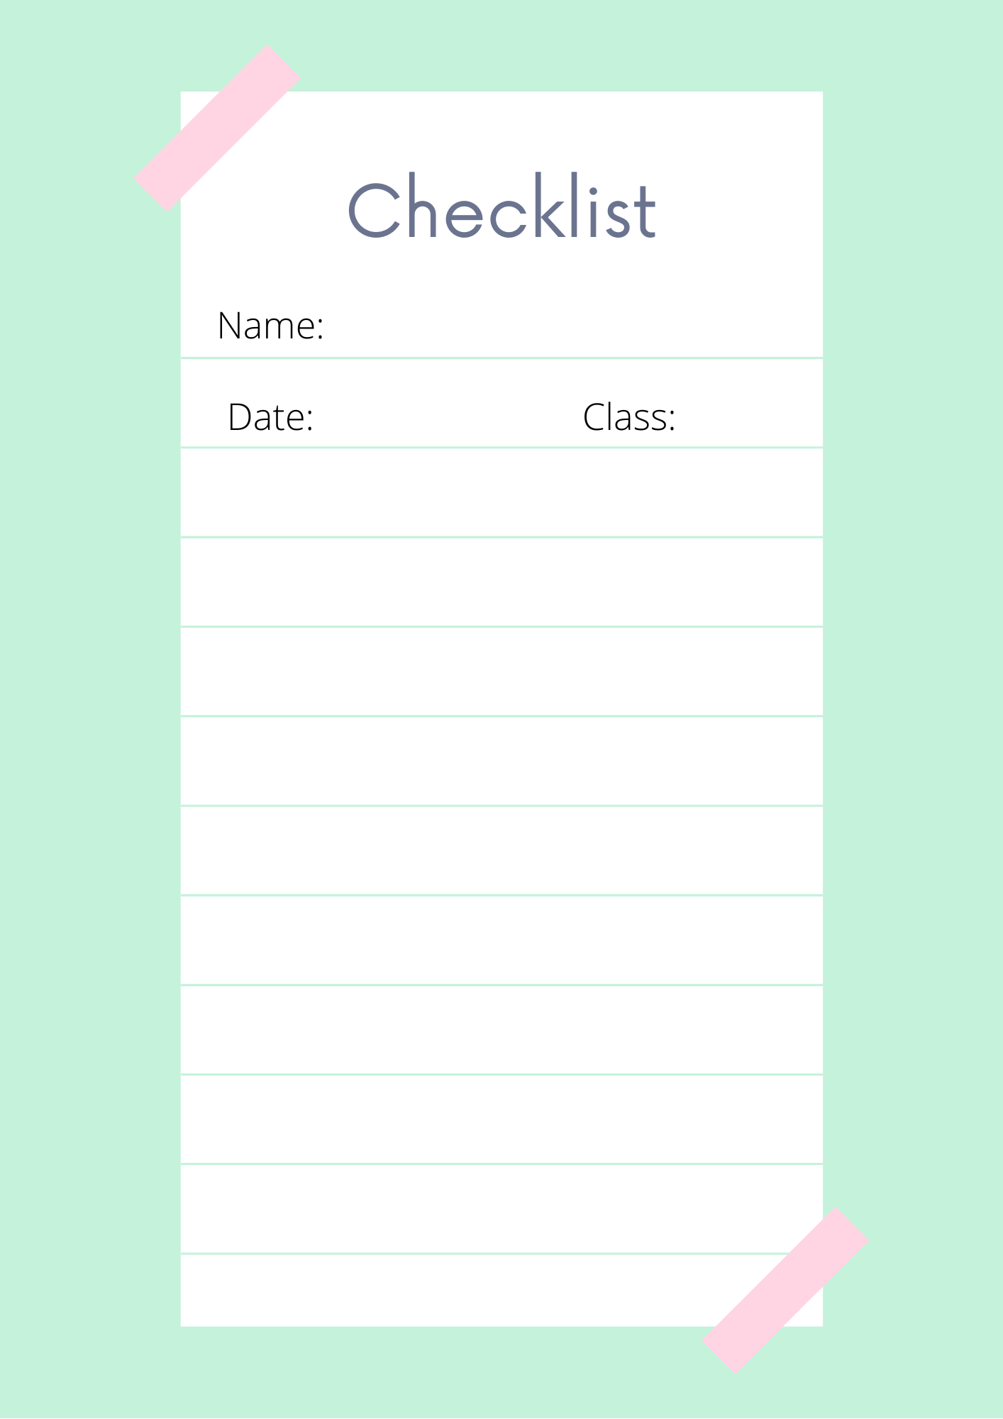
Students' name
Activity´s date
Grade
The student:
1
Add text here.
2
Add text here
3
Add text here
4
Add text here
Add your Bitmoji, sticker or signature here
Add your name here

Slide 8
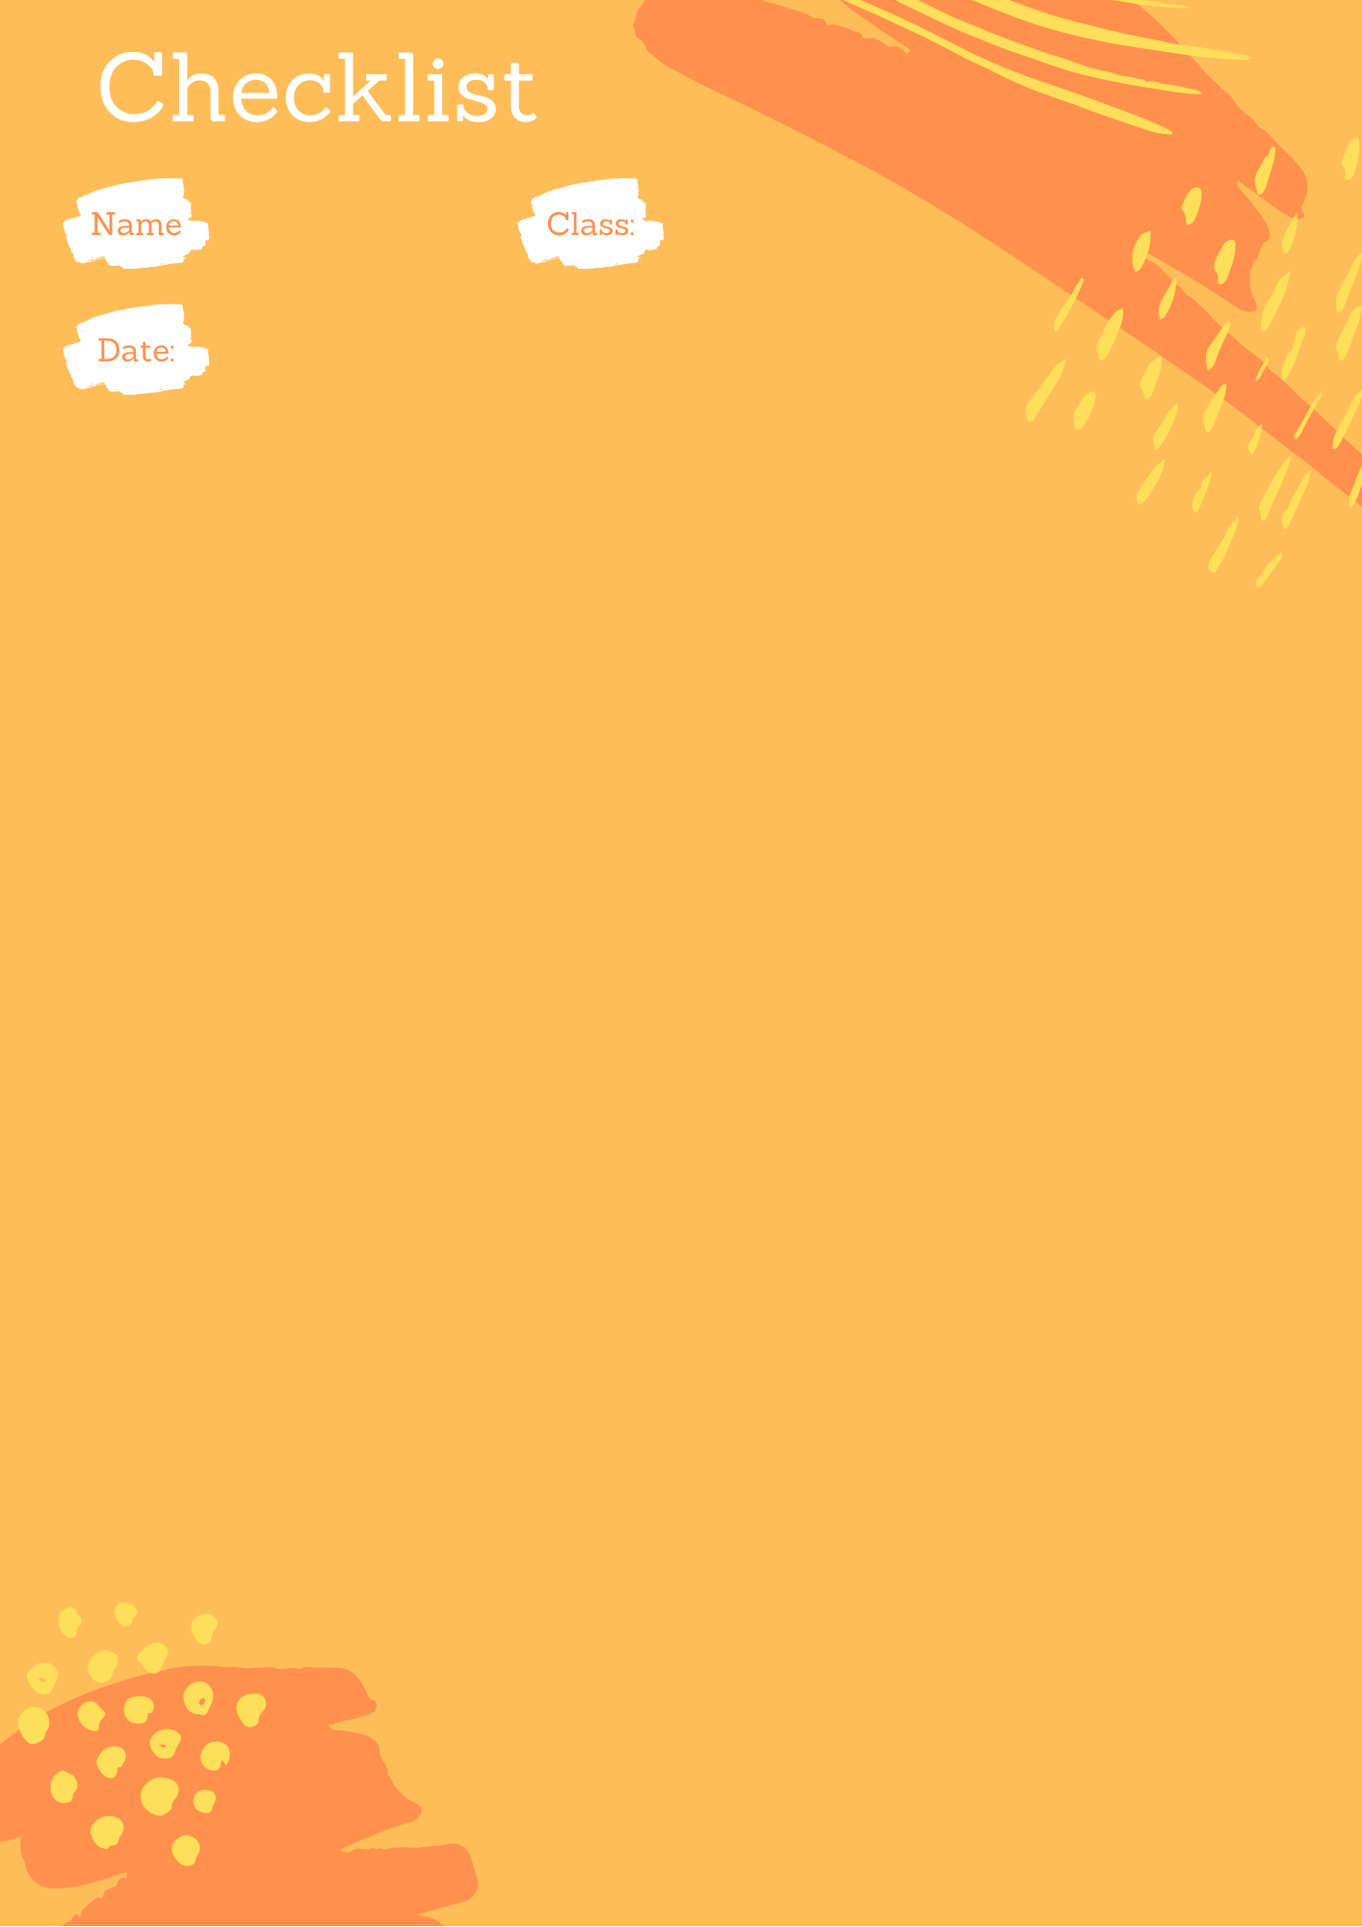
Students' name
Grade
Activity´s date
The student:
Add text here.
Add text here
Add text here
Add text here
Add your Bitmoji, sticker or signature here
Add your name here

Slide 9
Hello teachers
To help you prepare activities for distance teaching, we have created different templates to create material, contextualized games for practicing content of our curriculum and spreadsheets for data management.
These resources are part of an online teacher resource pack for you.
You are more than welcome to use and customize them as you need.
You can download this template and more resources from the website www.oportunidadenlinea.cl
See you soon.

