Slide 1

WhatsApp
rules
WhatsApp has been an essential and significant ally for many of you during this health crisis. Why? Because it has facilitated communication with students and their families. We want to help you make the best of this interaction, so we prepared different templates to create WhatsApp rules.
Instructions
In this presentation, you will find 4 different templates to organize the interaction among the WhatsApp groups you have so far.
In the next slides, you are going to find some suggestions as an example. You can change the information in the rest of them, add some extra things, and duplicate as many slides as you need.
When you finish, you can save them as images and send them by email or WhatsApp.
Logos you may need:
Insert your school’s badge so you can have quick access to it when needed.

Slide 2


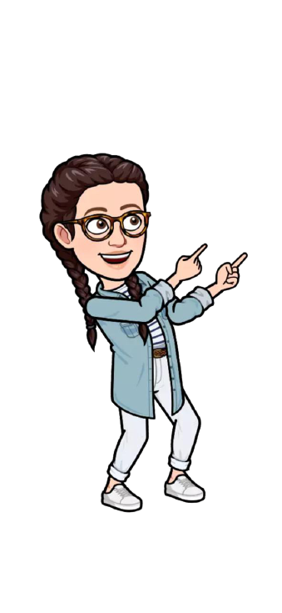


EXAMPLE
Show respect to everyone.
Be polite and listen when others are speaking/sharing.
Feel free to share and ask questions in office hours.
Always be kind.
Thanks. Miss Fernanda

Slide 3
EJEMPLO
Demuestra respeto por todos.
Se educado y escucha cuando otros hablen/compartan.
Siente la libertad de compartir o preguntar en horario de oficina.
Siempre se amable.
Gracias. Miss Fernanda

Slide 4
Add your school logo here
Add text here.
Add text here.
Add text here.
Add text here.
Add your signature here.

Slide 5
Add your school logo here
Add text here.
Add text here.
Add text here.
Add text here.
Add your signature here.

Slide 6


Add your school logo here
Add text here.
Add text here.
Add text here.
Add text here.
Add text here.
Add your signature here.

Slide 7
Add your school logo here
Add text here.
Add text here.
Add text here.
Add text here.
Add text here.
Add your signature here.

Slide 8



Add your school logo here
Add text here.
Add text here.
Add text here.
Add text here.
Add your signature here.

Slide 9
Add your school logo here
Add text here.
Add text here.
Add text here.
Add text here.
Add your signature here.

Slide 10

Add your school logo here
Add text here.
Add text here.
Add text here.
Add text here.
Add text here.
Add your signature here.

Slide 11
Add your school logo here
Add text here.
Add text here.
Add text here.
Add text here.
Add text here.
Add your signature here.

Slide 12
Hello teachers
To help you prepare activities for distance teaching, we have created different templates to create material, contextualized games for practicing content of our curriculum and spreadsheets for data management.
These resources are part of an online teacher resource pack for you.
You are more than welcome to use and customize them as you need.
You can download this template and more resources from the website www.oportunidadenlinea.cl
See you soon.

