Slide 1
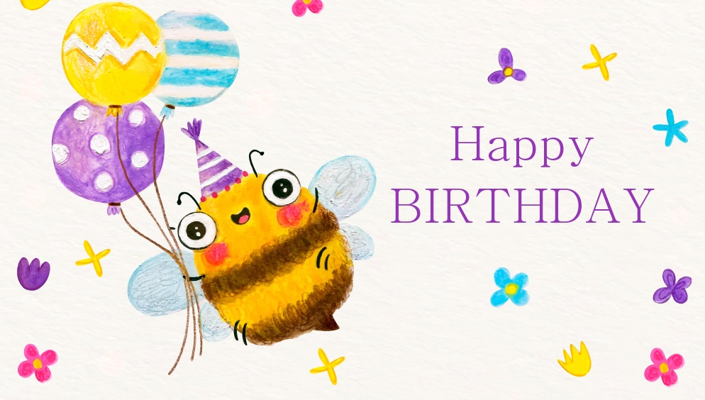

Kinder
My birthday wheel game!

Slide 2
Instructions:
Watch the video with the students by clicking on the picture.
Continue playing with the wheel, ask a student to stop it.
Ask a student (it could be the same or another one) to tell you the name of the picture indicated by the arrow when it stops.
First student to guess the name of the picture correctly wins!

Slide 3
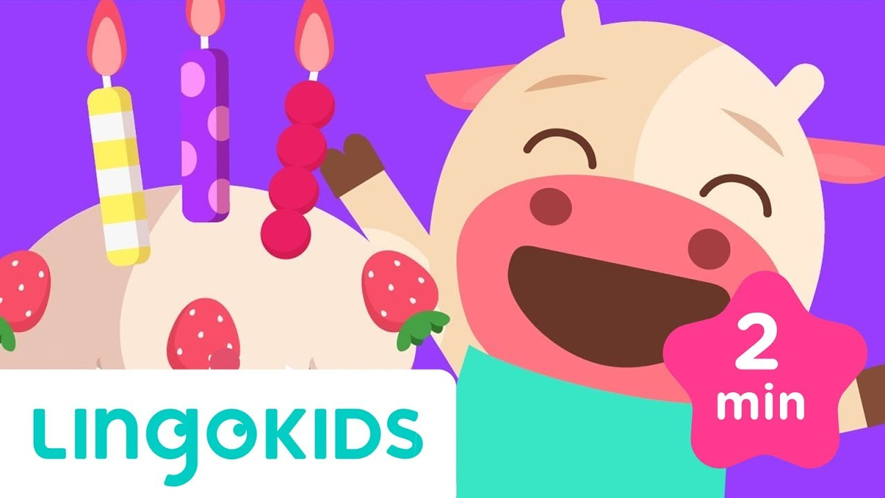
Let’s watch a video!

Slide 4
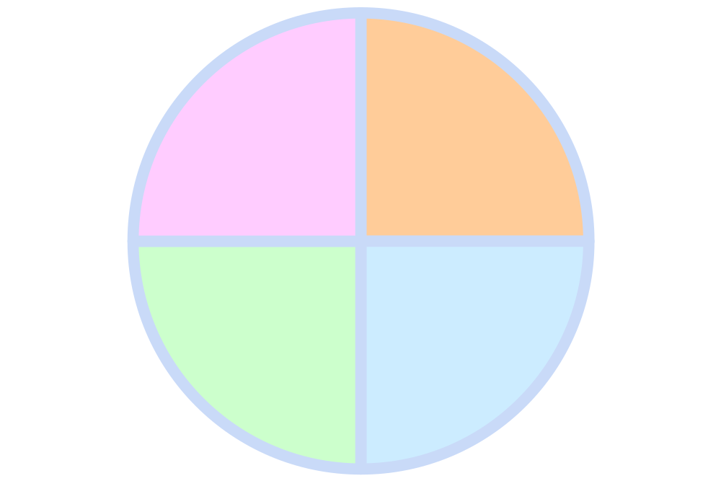



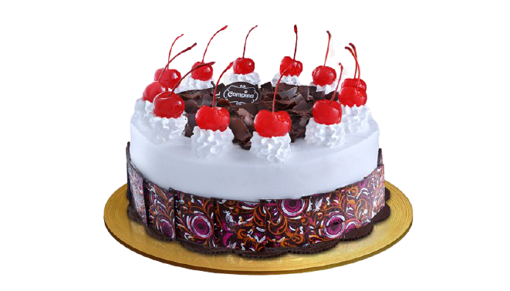
Let’s play!
Stop

Slide 5
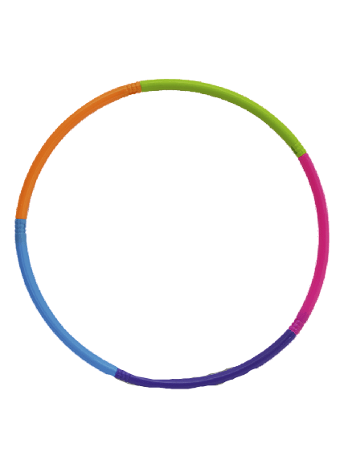
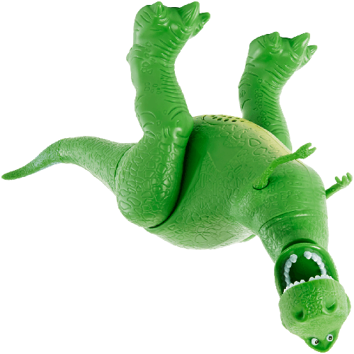
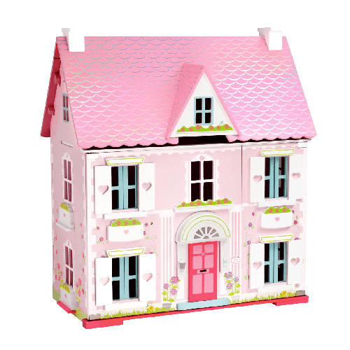
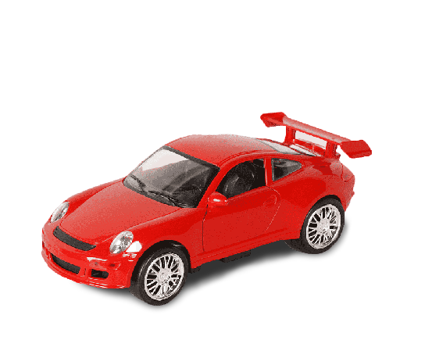
Let’s play!
Stop

Slide 7

Hello teachers
To help you prepare activities for distance teaching, we have created different templates to create material, contextualized games for practicing content of our curriculum and spreadsheets for data management.
These resources are part of an online teacher resource pack for you.
You are more than welcome to use and customize them as you need.
You can download this template and more resources from the website www.oportunidadenlinea.cl
See you soon.

