Slide 1


3rd grade: Actions guessing game!

Slide 2
Reveal the picture by saying the number
First student to guess and write the name of the picture correctly in the chat wins!

Slide 3

7
16
12
3
10
CLIMB
20
17
5
9
19
9
1
13
15
6
SHOW PICTURE!
4
18
11
14
2

Slide 4
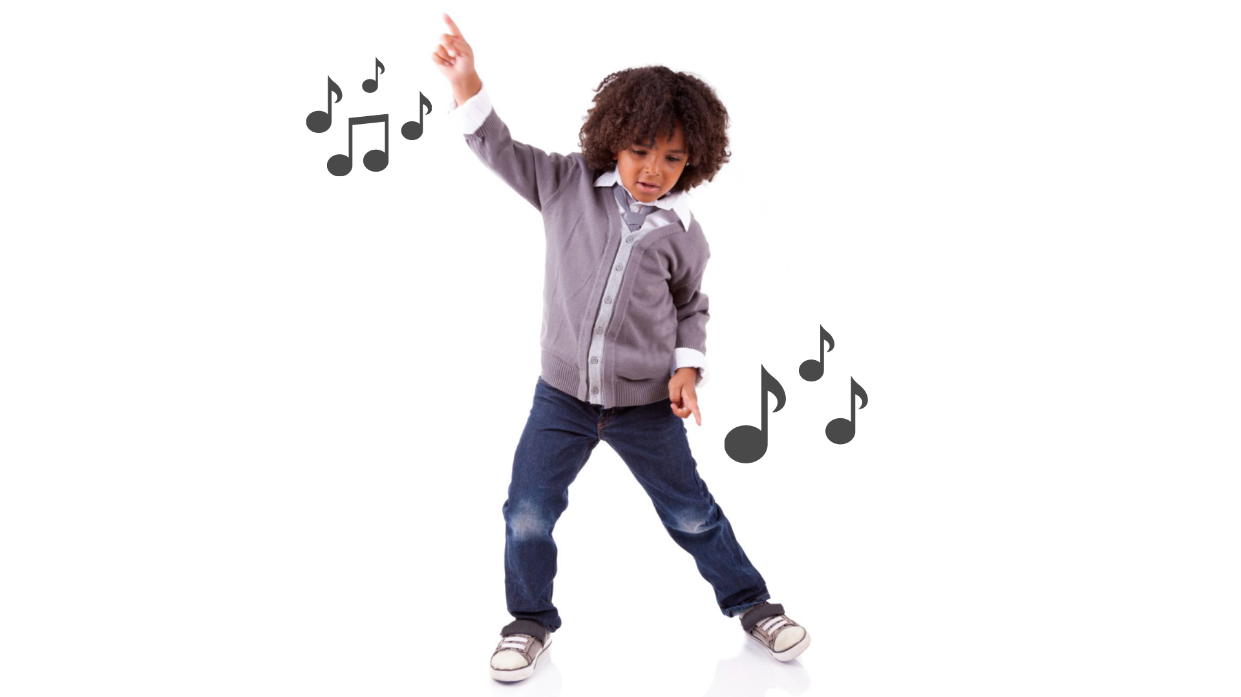
7
16
12
3
10
DANCE
20
17
5
9
19
9
1
13
15
6
SHOW PICTURE!
4
18
11
14
2

Slide 5

7
16
12
3
10
HOP
20
17
5
9
19
9
1
13
15
6
SHOW PICTURE!
4
18
11
14
2

Slide 6
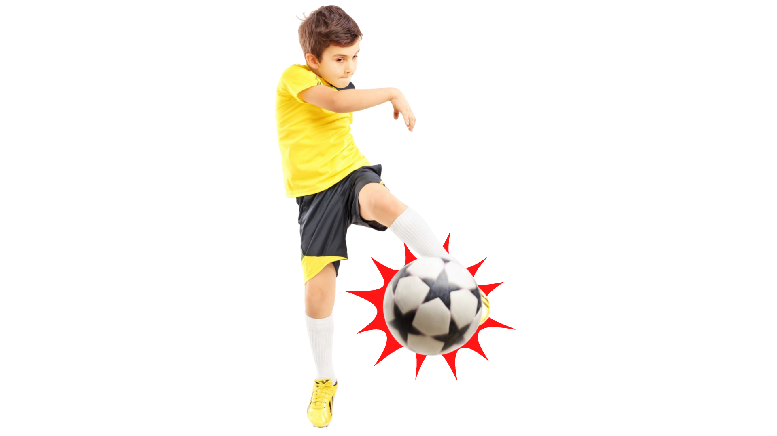
7
16
12
3
10
KICK A BALL
20
17
5
9
19
9
1
13
15
6
SHOW PICTURE!
4
18
11
14
2

Slide 7
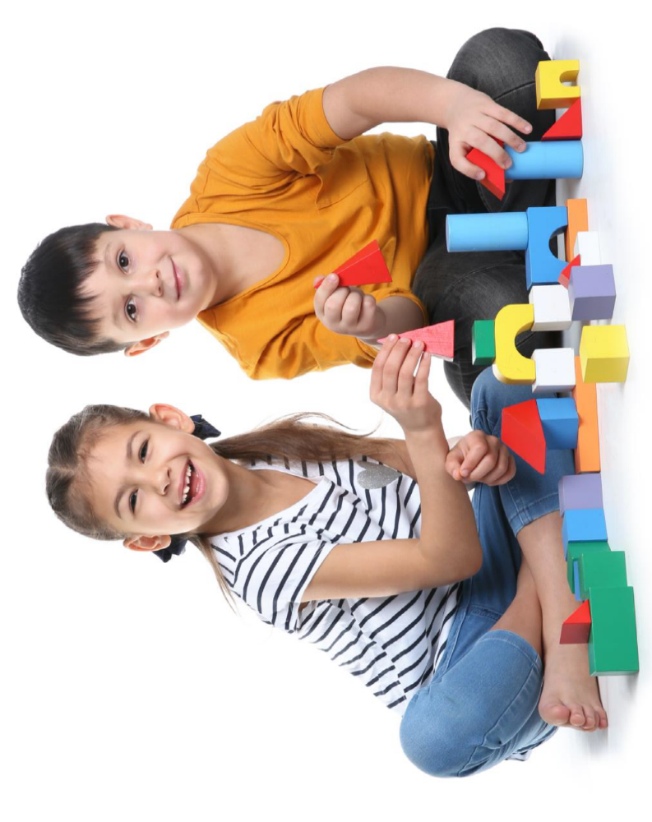
7
16
12
3
10
PLAY
20
17
5
9
19
9
1
13
15
6
SHOW PICTURE!
4
18
11
14
2

Slide 8
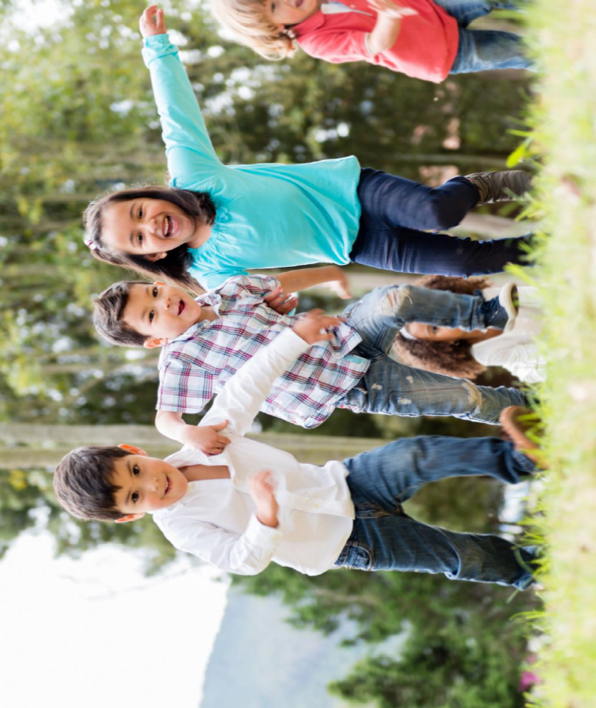
7
16
12
3
10
RUN
20
17
5
9
19
9
1
13
15
6
SHOW PICTURE!
4
18
11
14
2

Slide 9
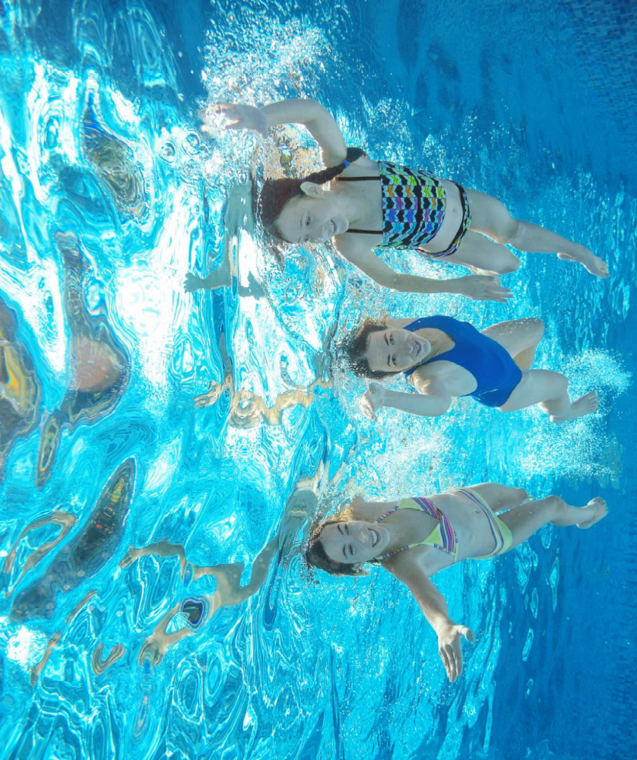
7
16
12
3
10
SWIM
20
17
5
9
19
9
1
13
15
6
SHOW PICTURE!
4
18
11
14
2

Slide 10
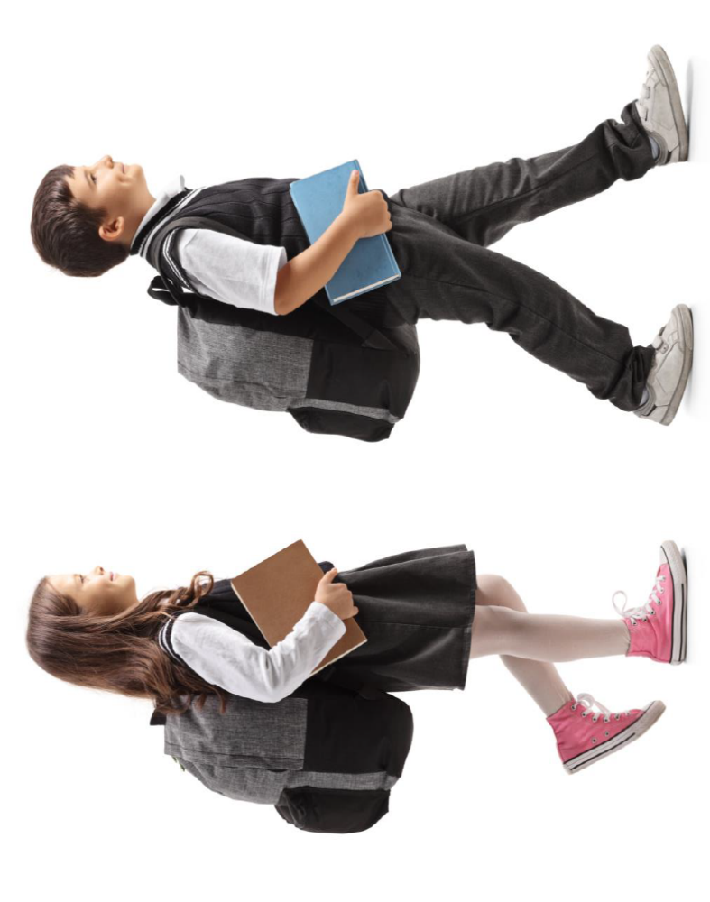
7
16
12
3
10
WALK
20
17
5
9
19
9
1
13
15
6
SHOW PICTURE!
4
18
11
14
2

Slide 11
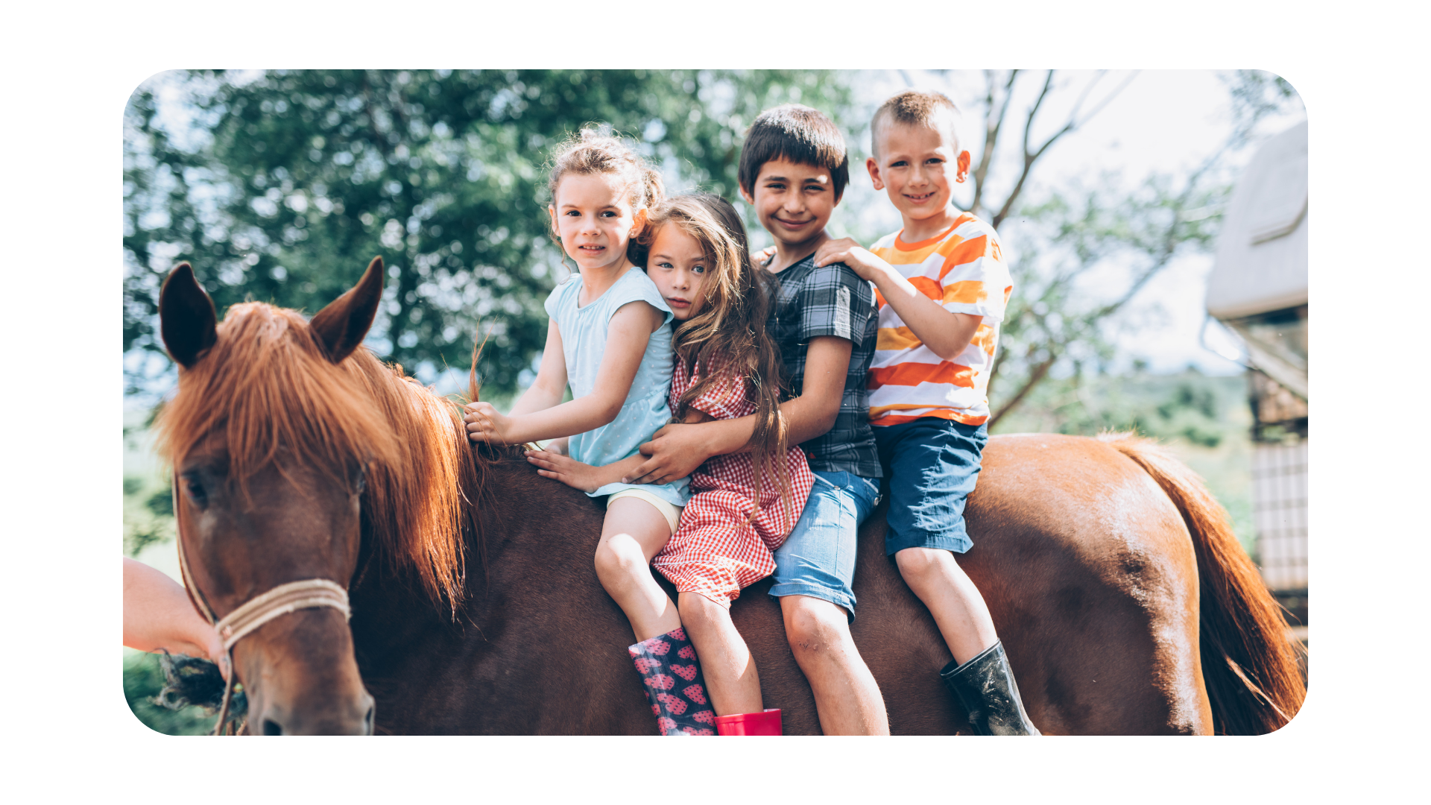
7
16
12
3
10
RIDE
20
17
5
9
19
9
1
13
15
6
SHOW PICTURE!
4
18
11
14
2

