Slide 1
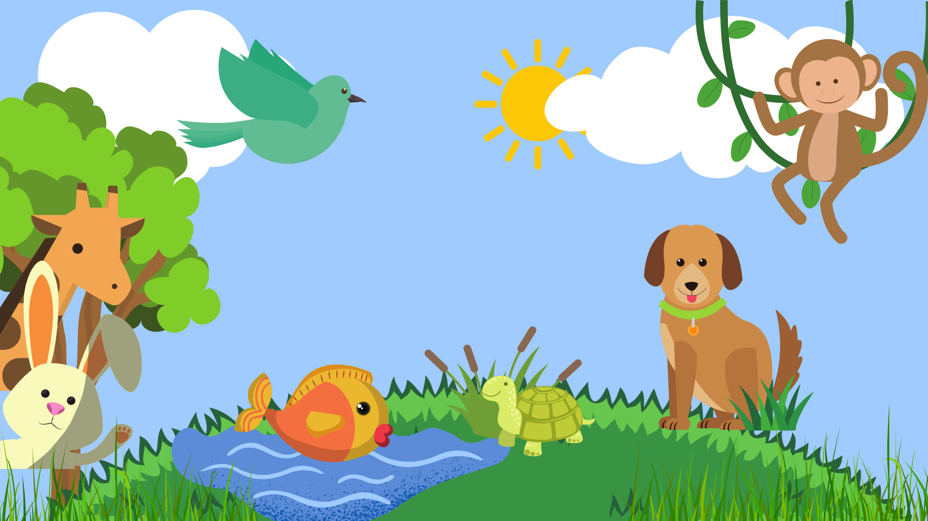

4th grade: Animal body parts guessing game!

Slide 2
Reveal the picture by saying the number
First student to guess and write the name of the picture correctly in the chat wins!

Slide 3
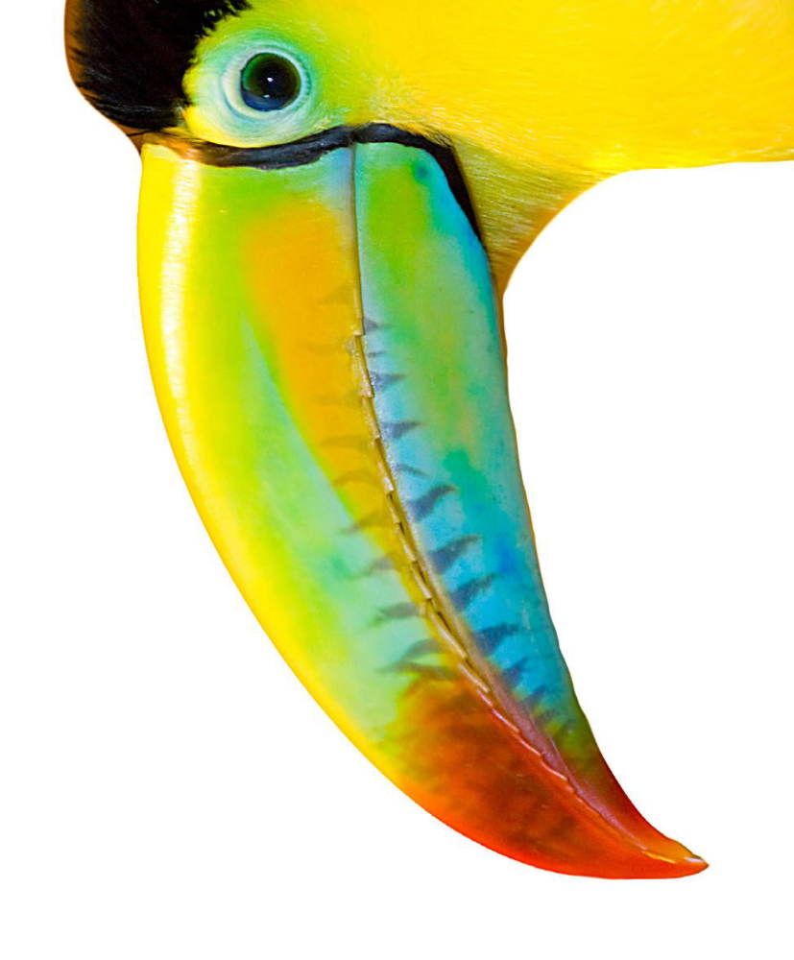
1
2
3
4
5
BEAK
6
7
8
9
10
11
12
13
14
15
SHOW PICTURE!
16
17
18
19
20

Slide 4
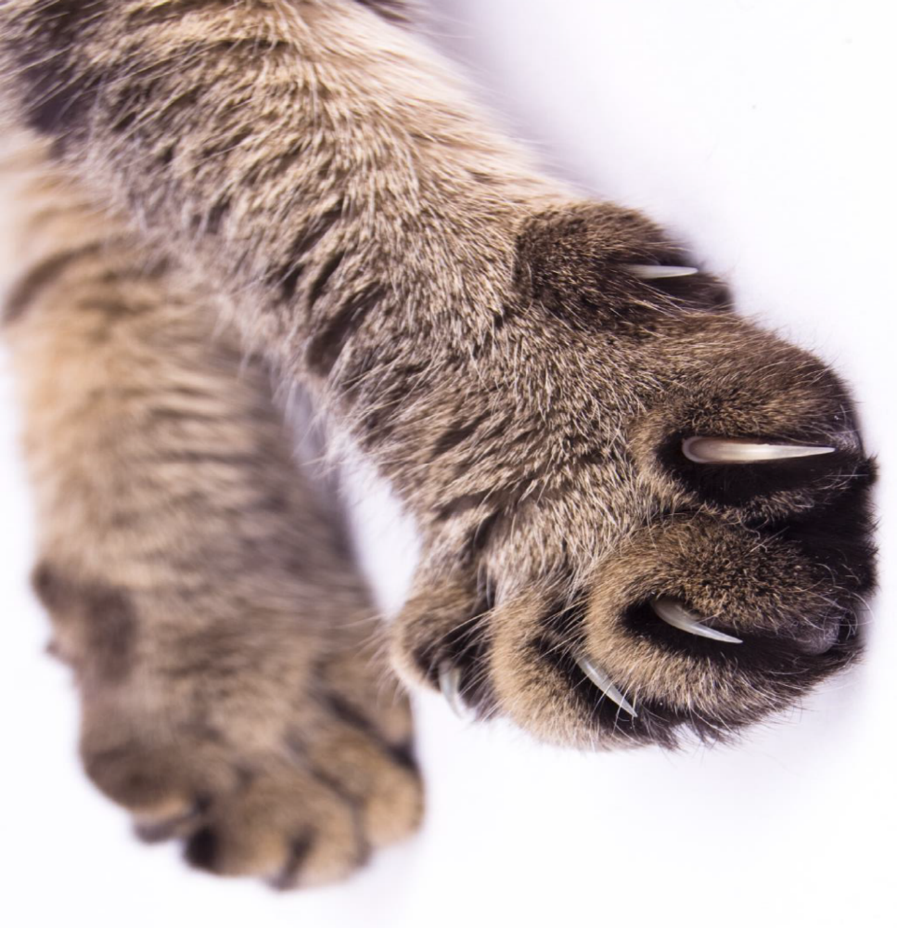
1
2
3
4
5
CLAWS
6
7
8
9
10
11
12
13
14
15
SHOW PICTURE!
16
17
18
19
20

Slide 5
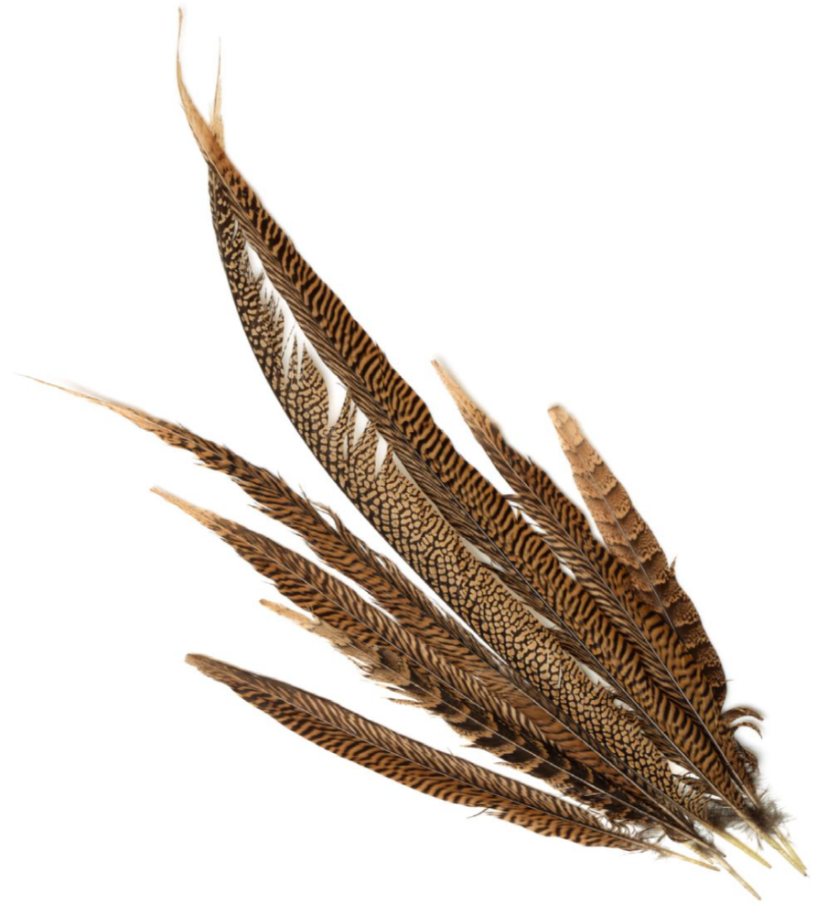
1
2
3
4
5
FEATHERS
6
7
8
9
10
11
12
13
14
15
SHOW PICTURE!
16
17
18
19
20

Slide 6
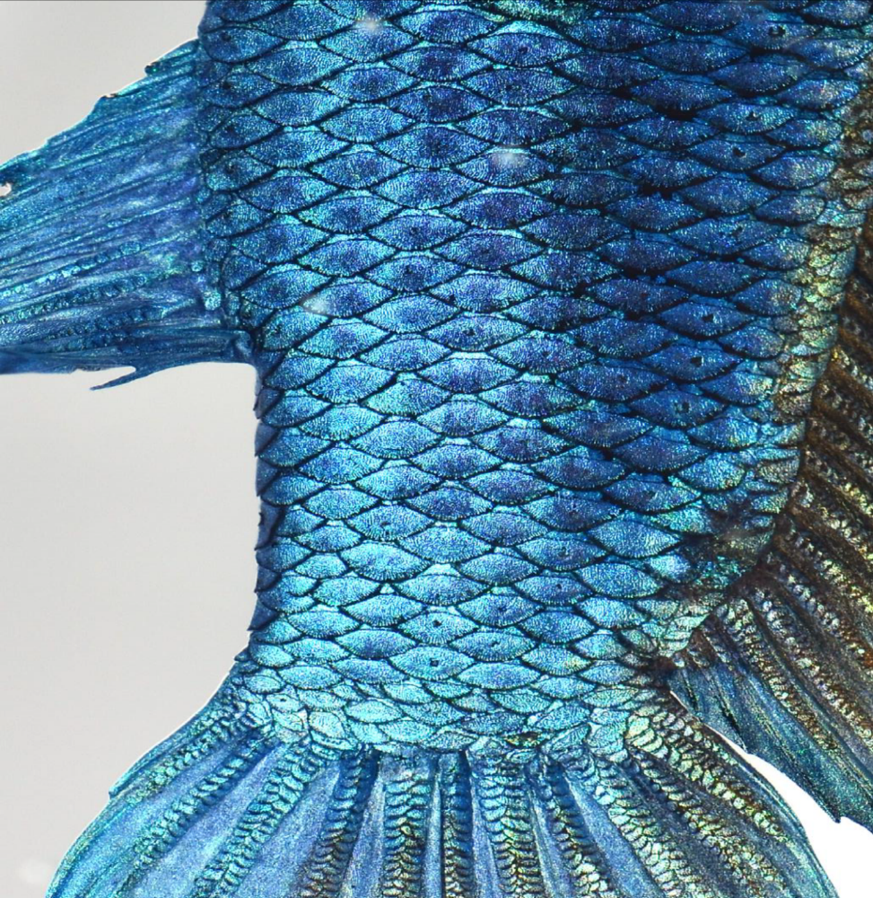
1
2
3
4
5
SCALES
6
7
8
9
10
11
12
13
14
15
SHOW PICTURE!
16
17
18
19
20

Slide 7
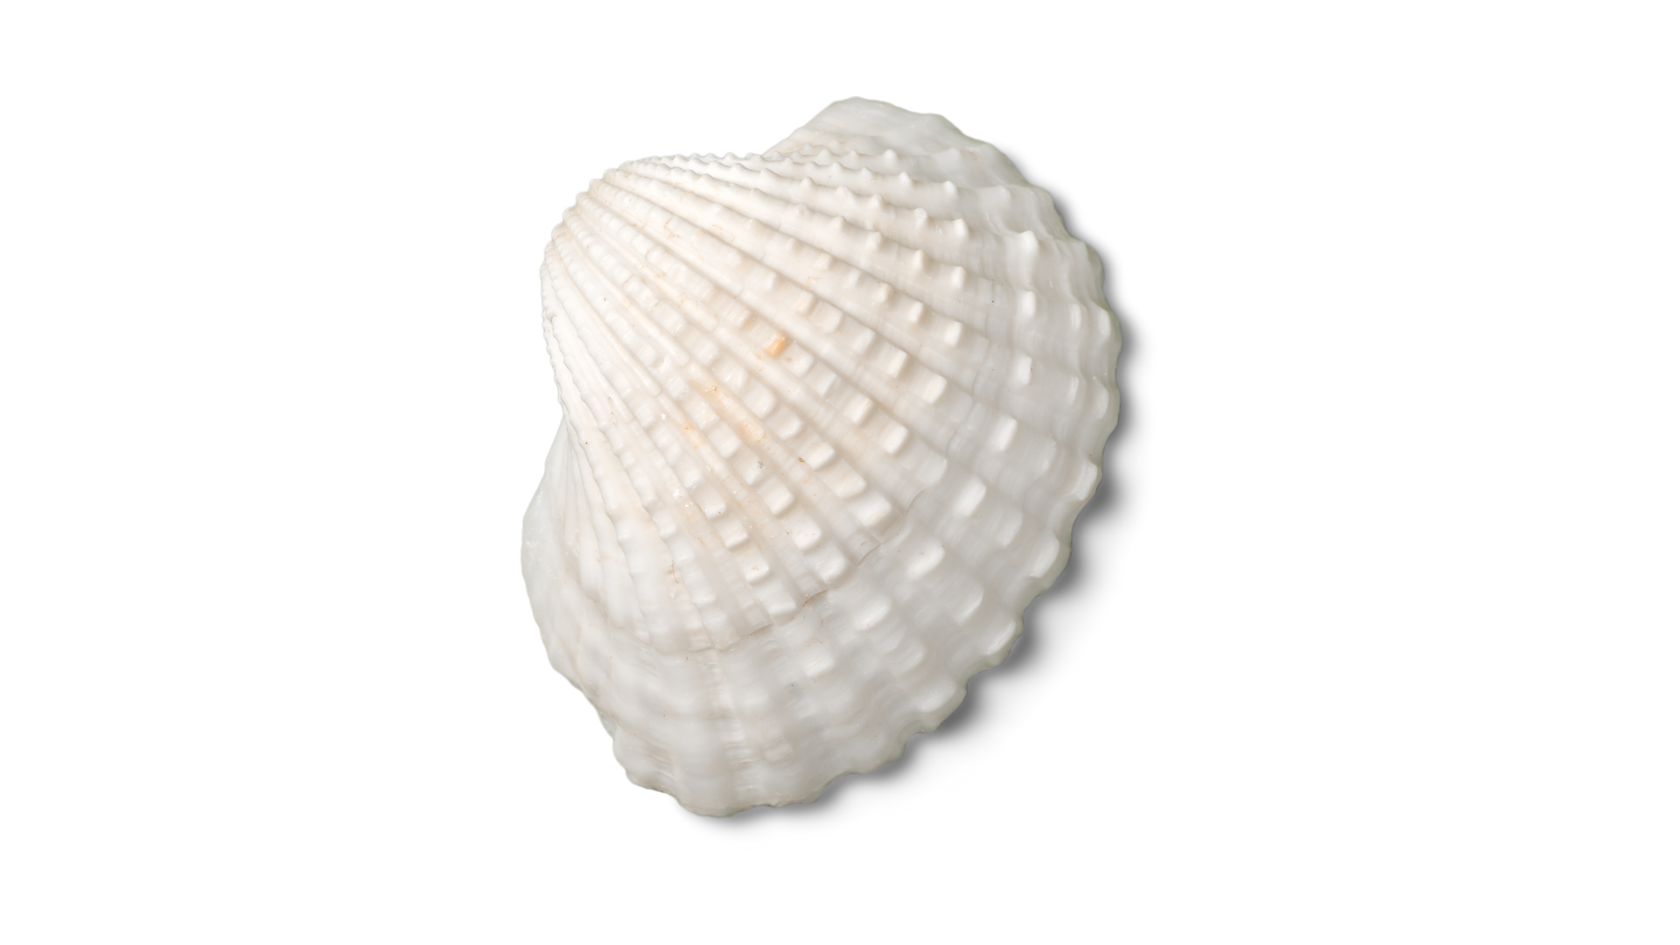
1
2
3
4
5
SHELL
6
7
8
9
10
11
12
13
14
15
SHOW PICTURE!
16
17
18
19
20

Slide 8
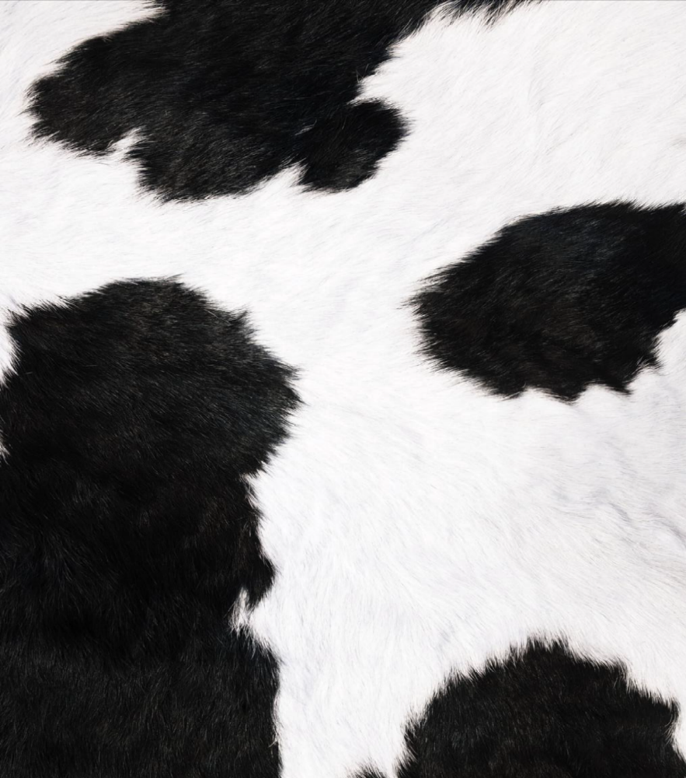
1
2
3
4
5
FUR
6
7
8
9
10
11
12
13
14
15
SHOW PICTURE!
16
17
18
19
20

Slide 9
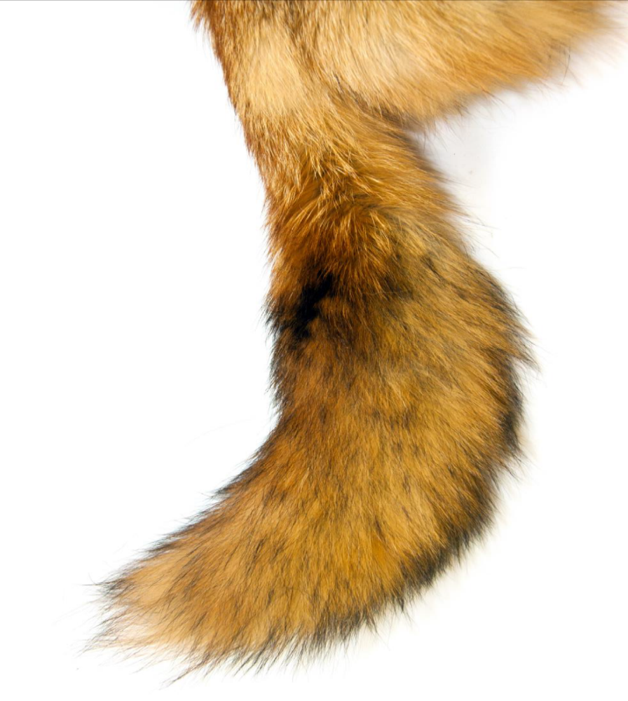
1
2
3
4
5
TAIL
6
7
8
9
10
11
12
13
14
15
SHOW PICTURE!
16
17
18
19
20

Slide 10
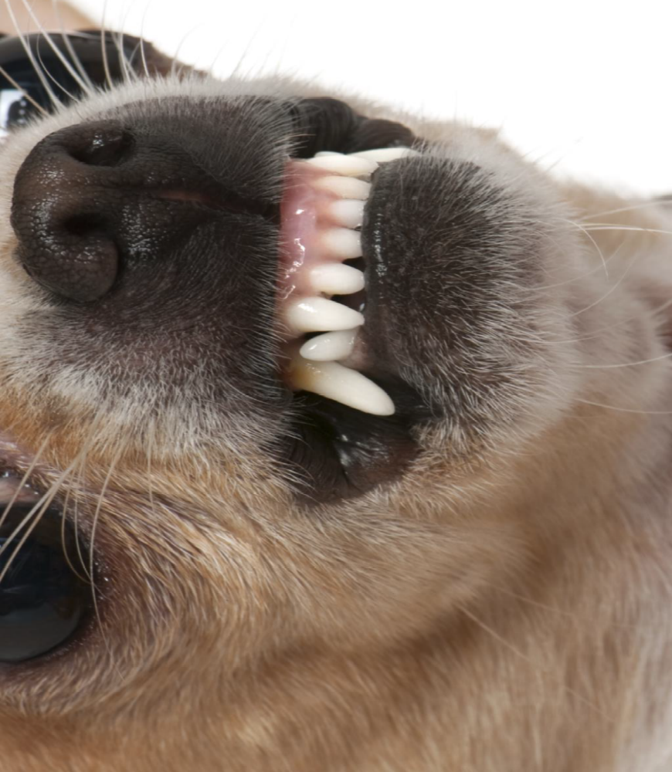
1
2
3
4
5
TEETH
6
7
8
9
10
11
12
13
14
15
SHOW PICTURE!
16
17
18
19
20

Slide 11
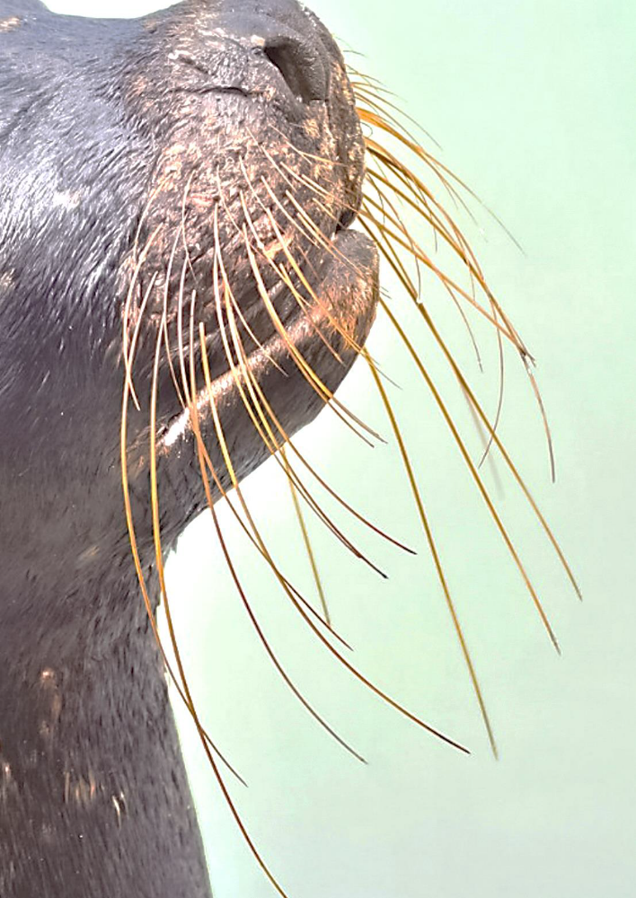
1
2
3
4
5
WHISKERS
6
7
8
9
10
11
12
13
14
15
SHOW PICTURE!
16
17
18
19
20

Slide 12
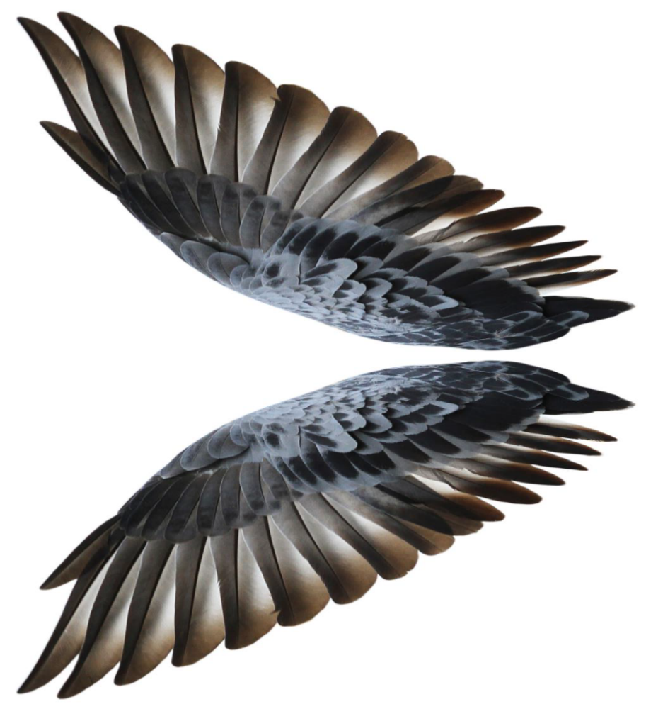
1
2
3
4
5
WINGS
6
7
8
9
10
11
12
13
14
15
SHOW PICTURE!
16
17
18
19
20

