Slide 1


1° grade: Activities guessing game!

Slide 2
Reveal the picture by saying the number
First student to guess and write the name of the picture correctly in the chat wins!

Slide 3
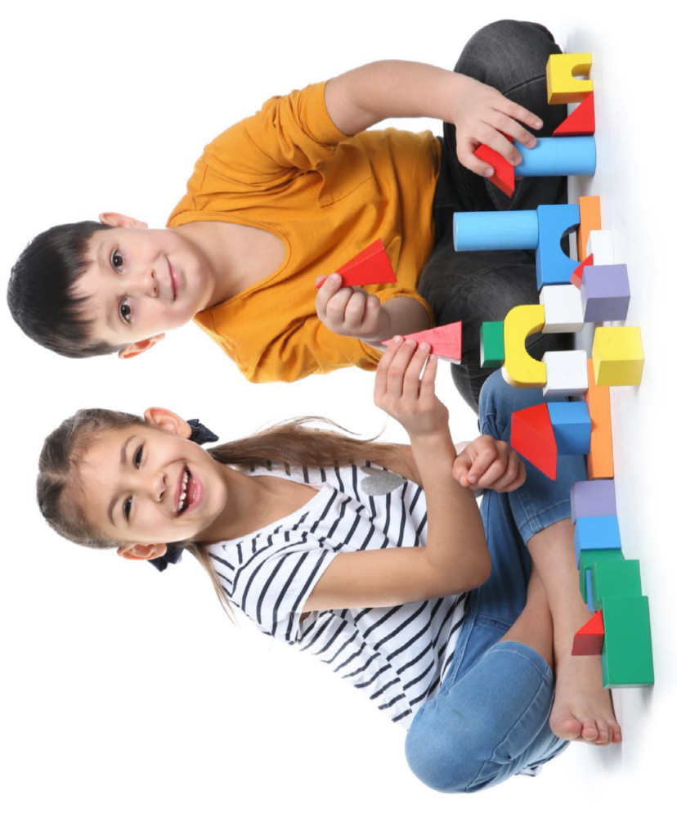
5
14
11
1
7
PLAY
6
13
15
20
3
8
19
4
2
17
SHOW PICTURE!
16
15
18
9
10

Slide 4
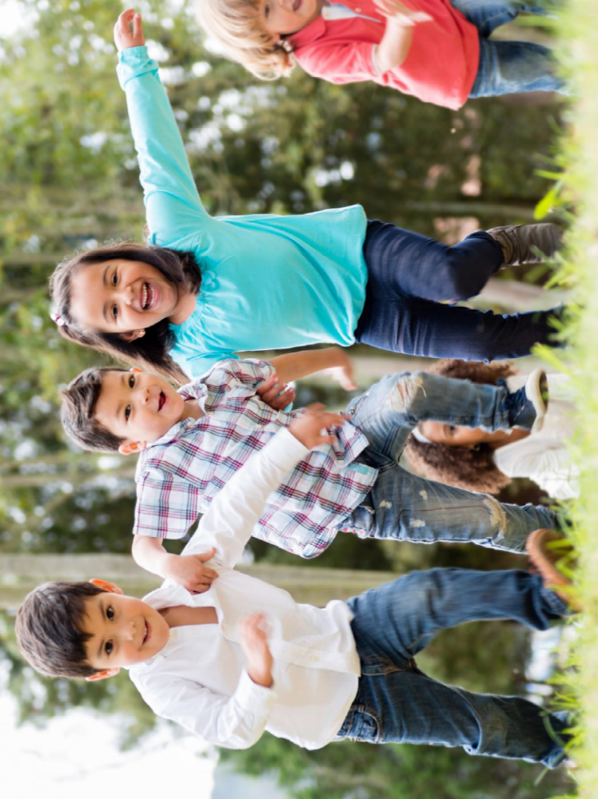
5
14
11
1
7
RUN
6
13
15
20
3
8
19
4
2
17
SHOW PICTURE!
16
15
18
9
10

Slide 5
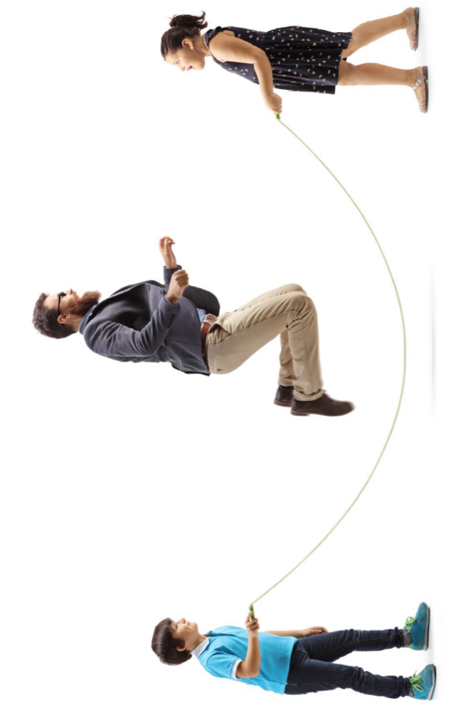
5
14
11
1
7
JUMP
6
13
15
20
3
8
19
4
2
17
SHOW PICTURE!
16
15
18
9
10

Slide 6
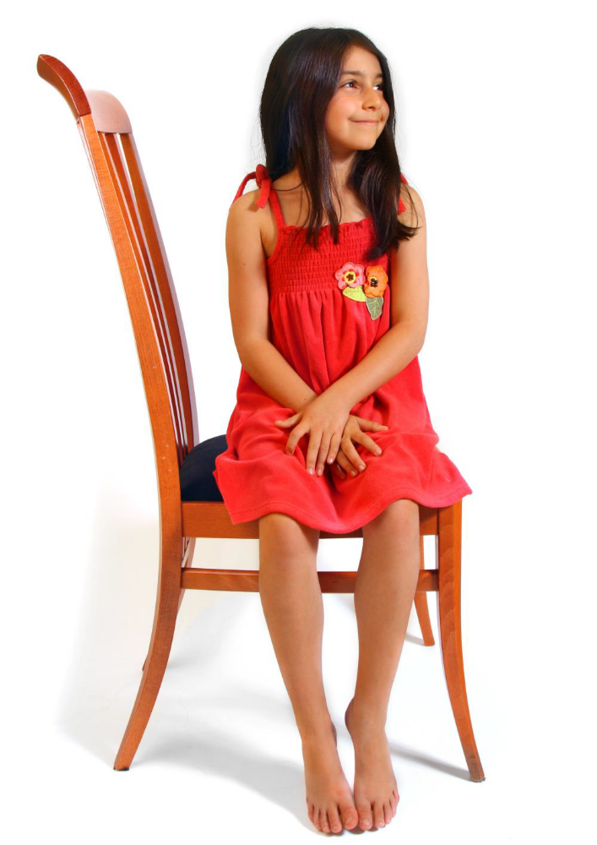
5
14
11
1
7
SIT
6
13
15
20
3
8
19
4
2
17
SHOW PICTURE!
16
15
18
9
10

Slide 7
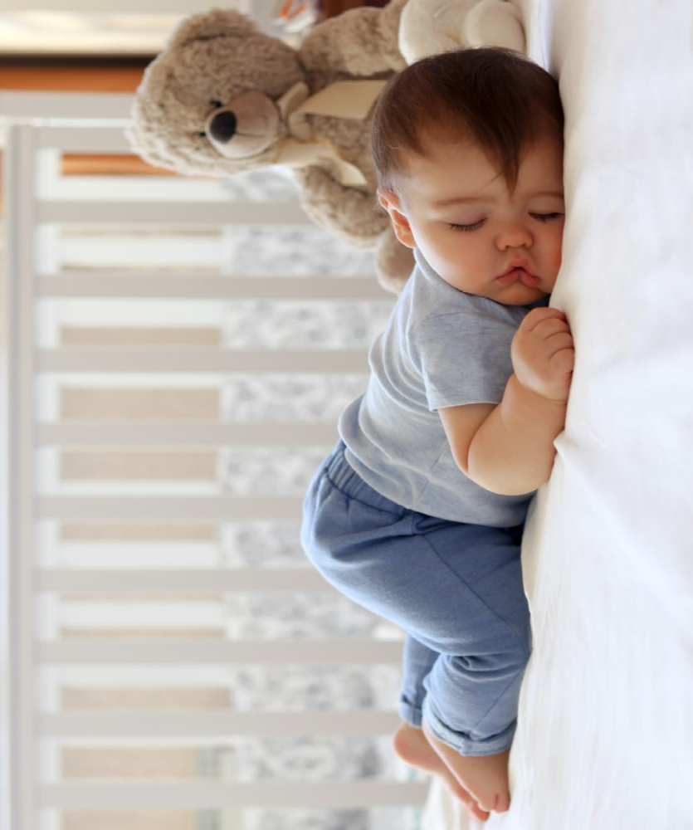
5
14
11
1
7
SLEEP
6
13
15
20
3
8
19
4
2
17
SHOW PICTURE!
16
15
18
9
10

Slide 8
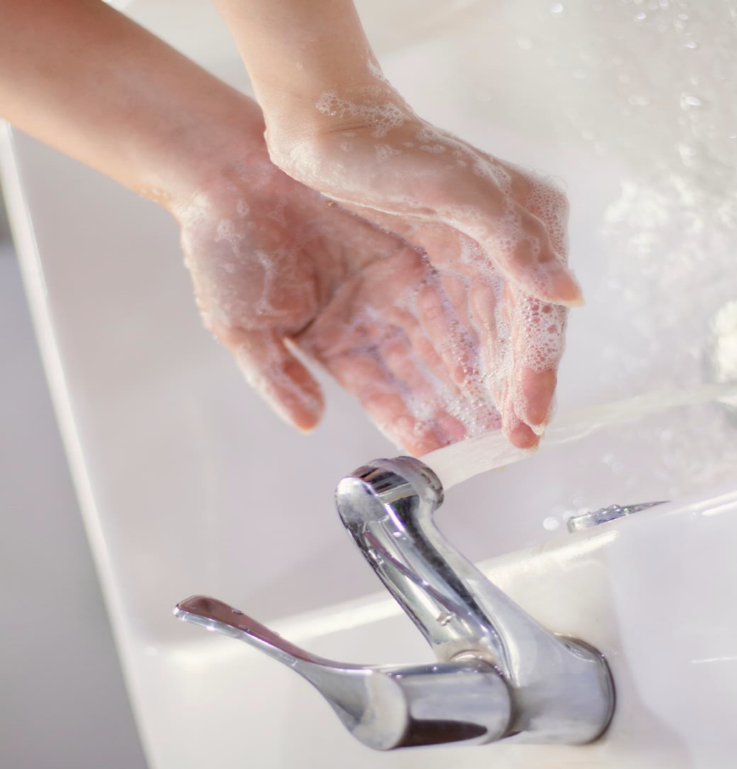
5
14
11
1
7
WASH
6
13
15
20
3
8
19
4
2
17
SHOW PICTURE!
16
15
18
9
10

Slide 9
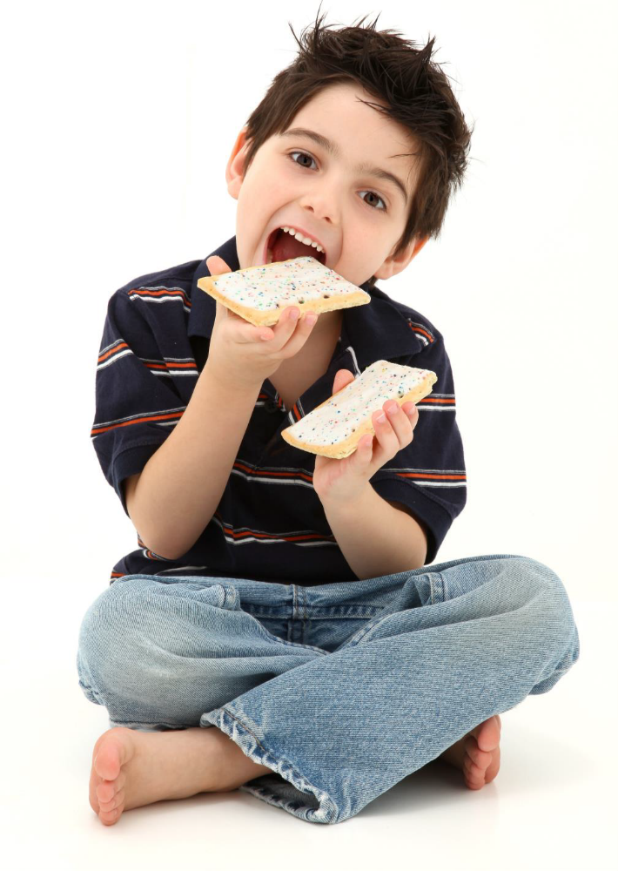
5
14
11
1
7
EAT
6
13
15
20
3
8
19
4
2
17
SHOW PICTURE!
16
15
18
9
10

