Slide 1


Slide 2


Slide 3

INSERT YOUR BITMOJI HERE

Slide 4
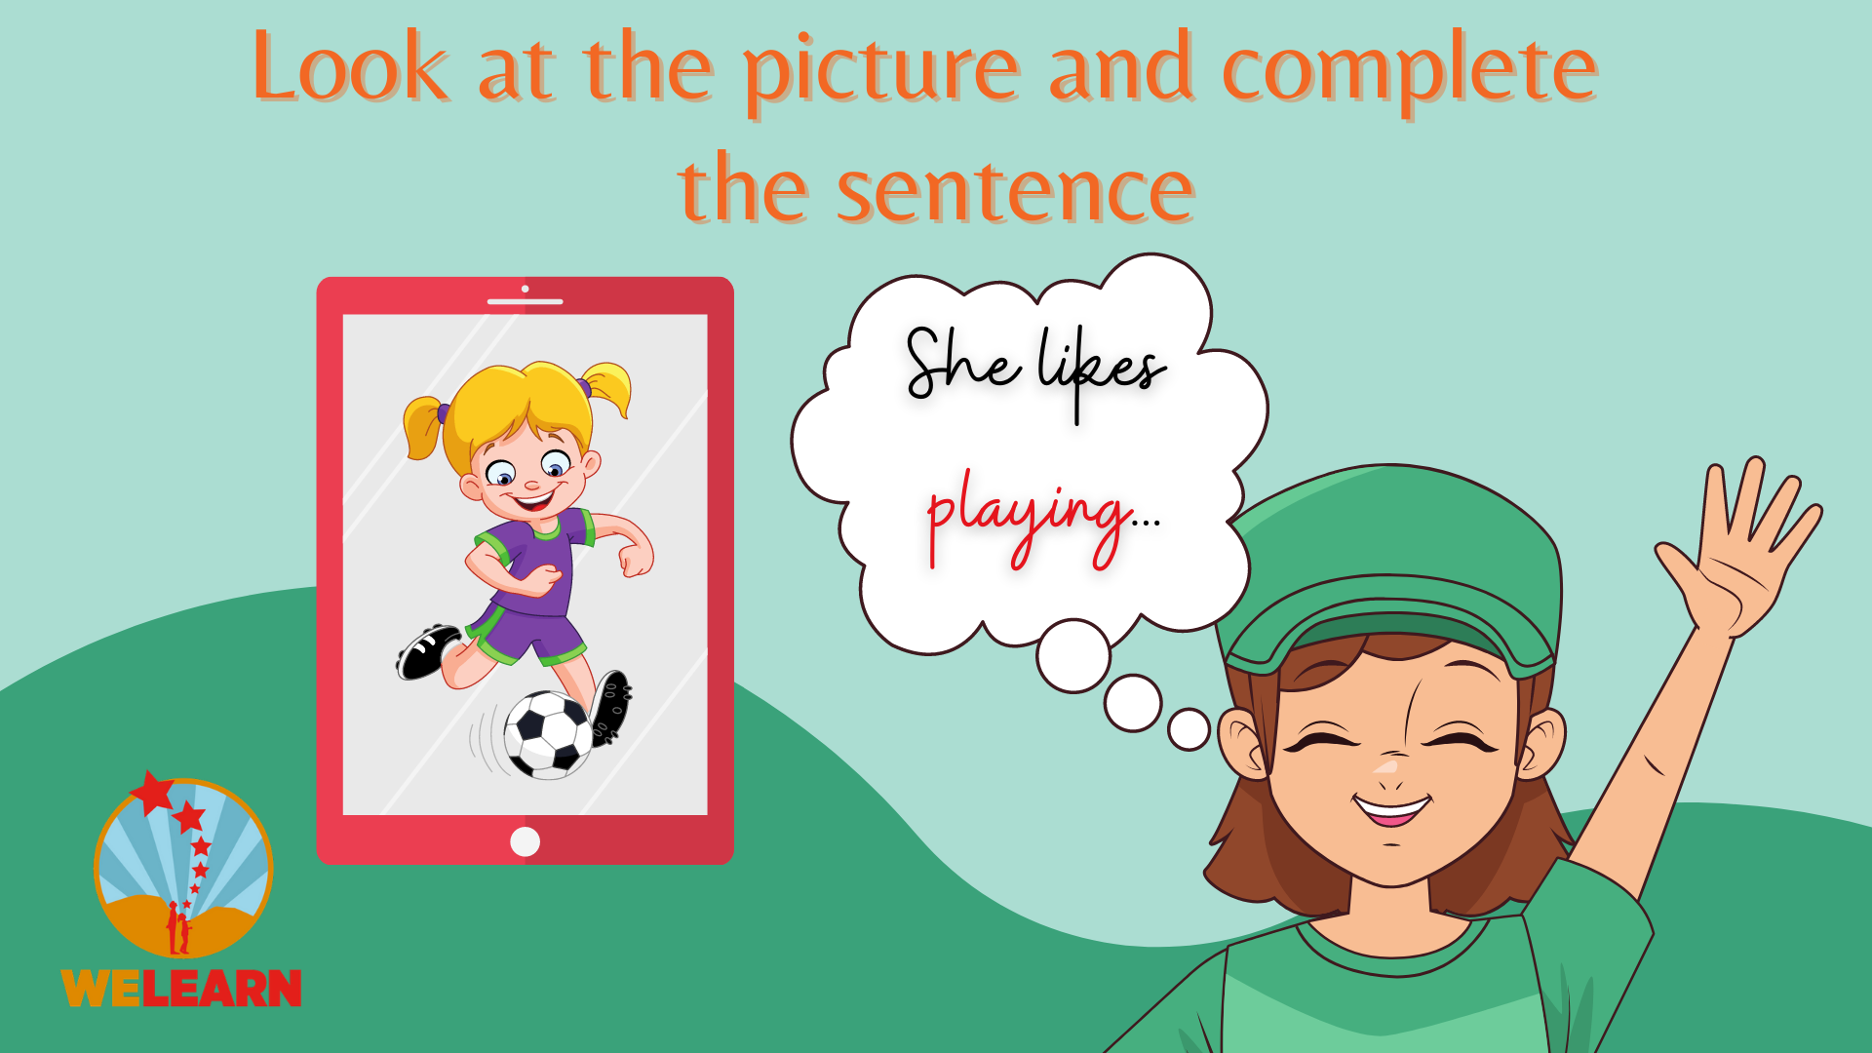


Slide 5

Check your answer here!

Slide 6

Check your answer here!

Slide 7

Check your answer here!

Slide 8

Check your answer here!

Slide 9

Check your answer here!

Slide 10


Slide 11

Check your answer here!

Slide 12

Check your answer here!

Slide 13

Check your answer here!

Slide 14

Check your answer here!

Slide 15


Slide 16

Check your answer here!

Slide 17

Check your answer here!

Slide 18

Check your answer here!

Slide 19

Check your answer here!

Slide 20


Slide 21

Check your answer here!

Slide 22

Check your answer here!

Slide 23

Check your answer here!

Slide 24


Slide 25


